Slide 1
Plots for blood/brain atlas
Wen Zhong
20181219

Slide 2
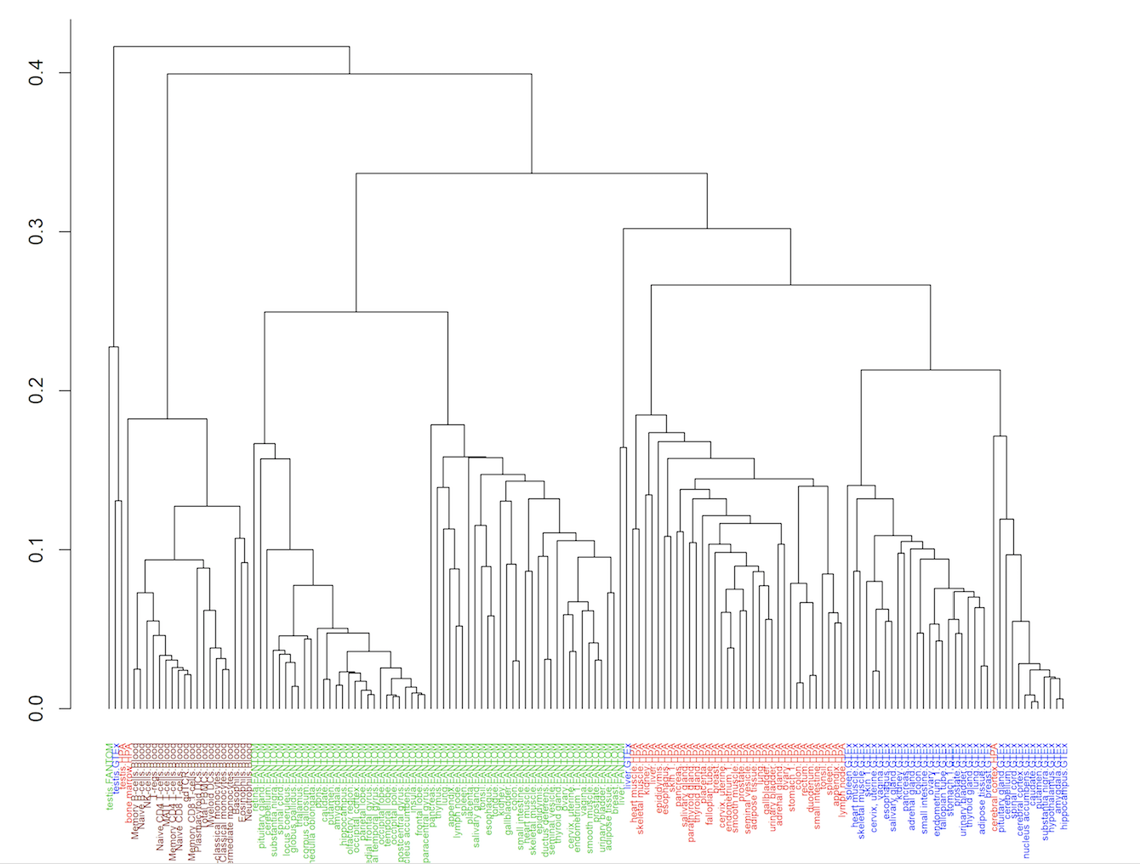
0. all tissues– all tissue types (Max sample clustering, Wen tSNE…)
Blood – sample level
tSNE / umap/ PCA/ dendrogram
Brain atlas all cell types species

Slide 3
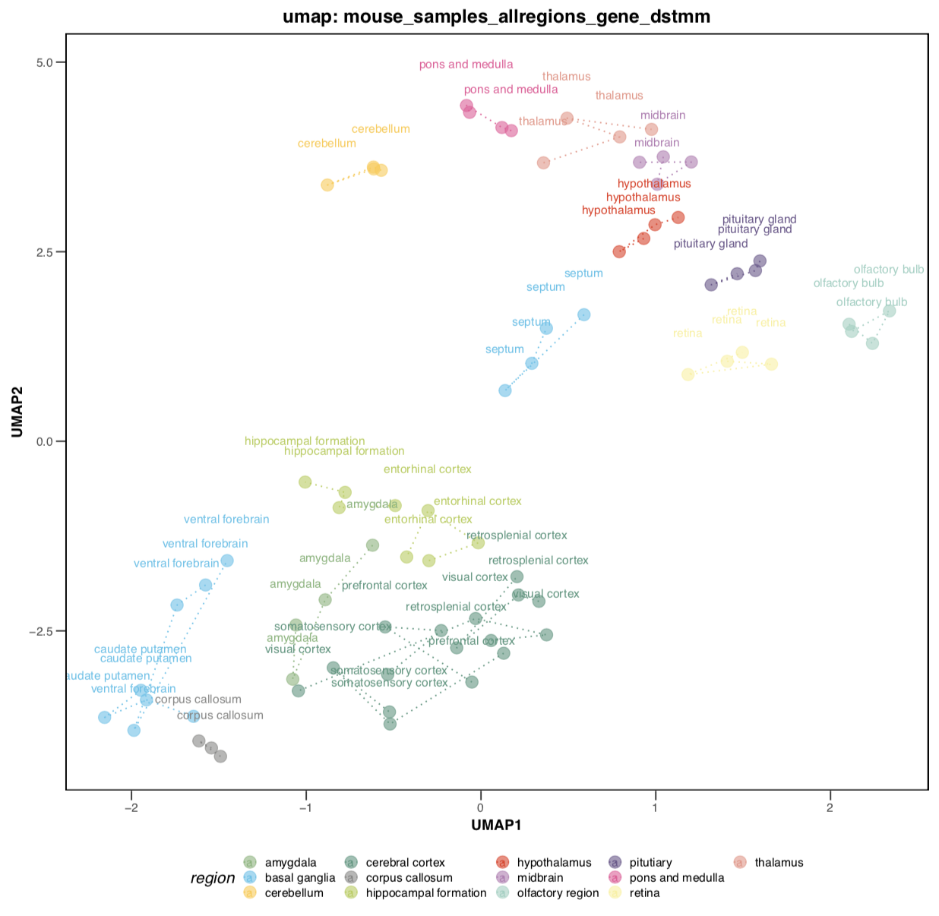
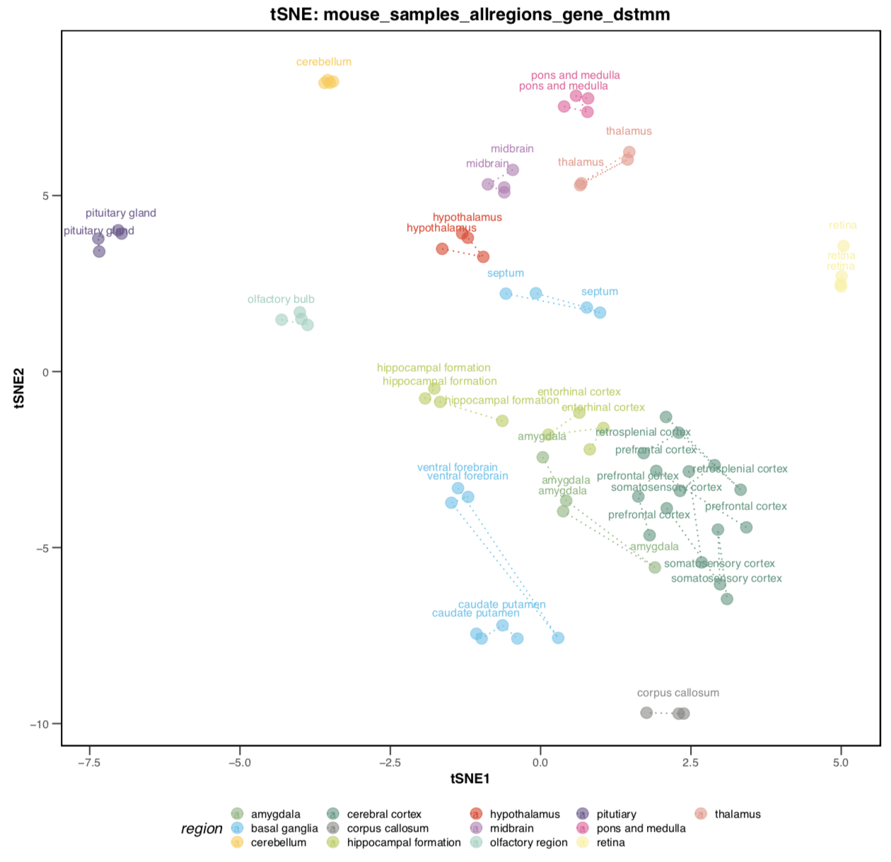
Overview – raw data (mouse, all samples)

Slide 4
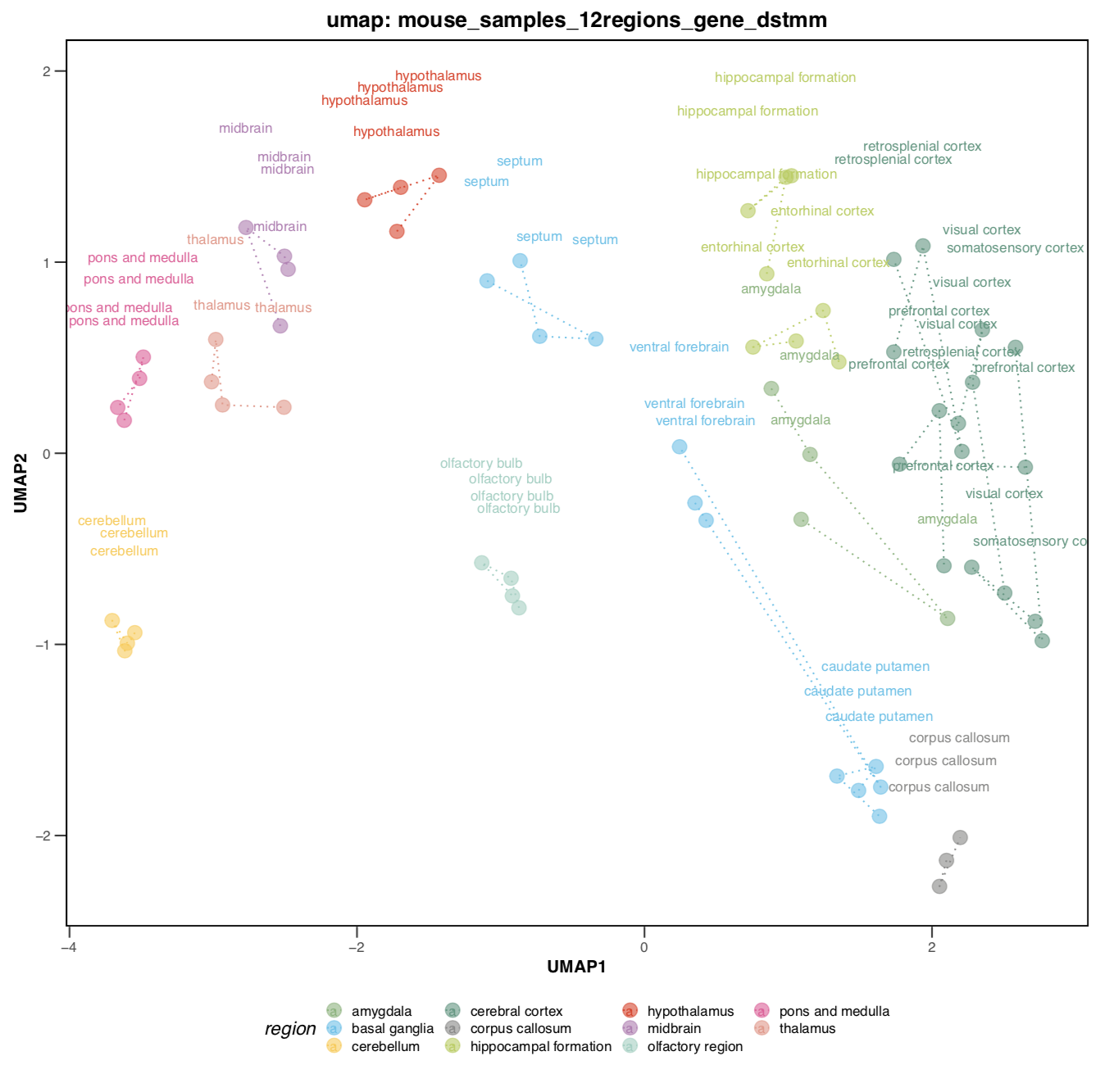
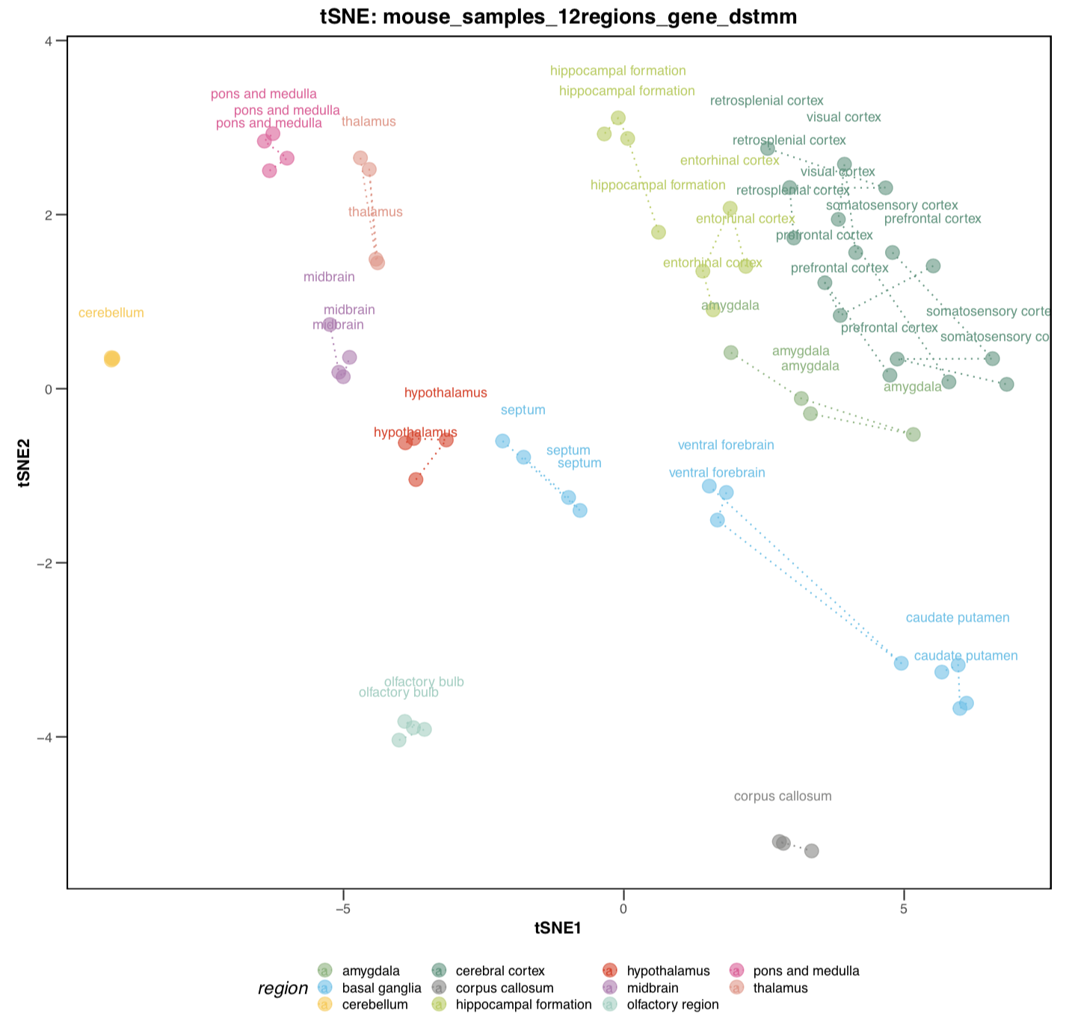
Overview – raw data (mouse, 11 regions)

Slide 5
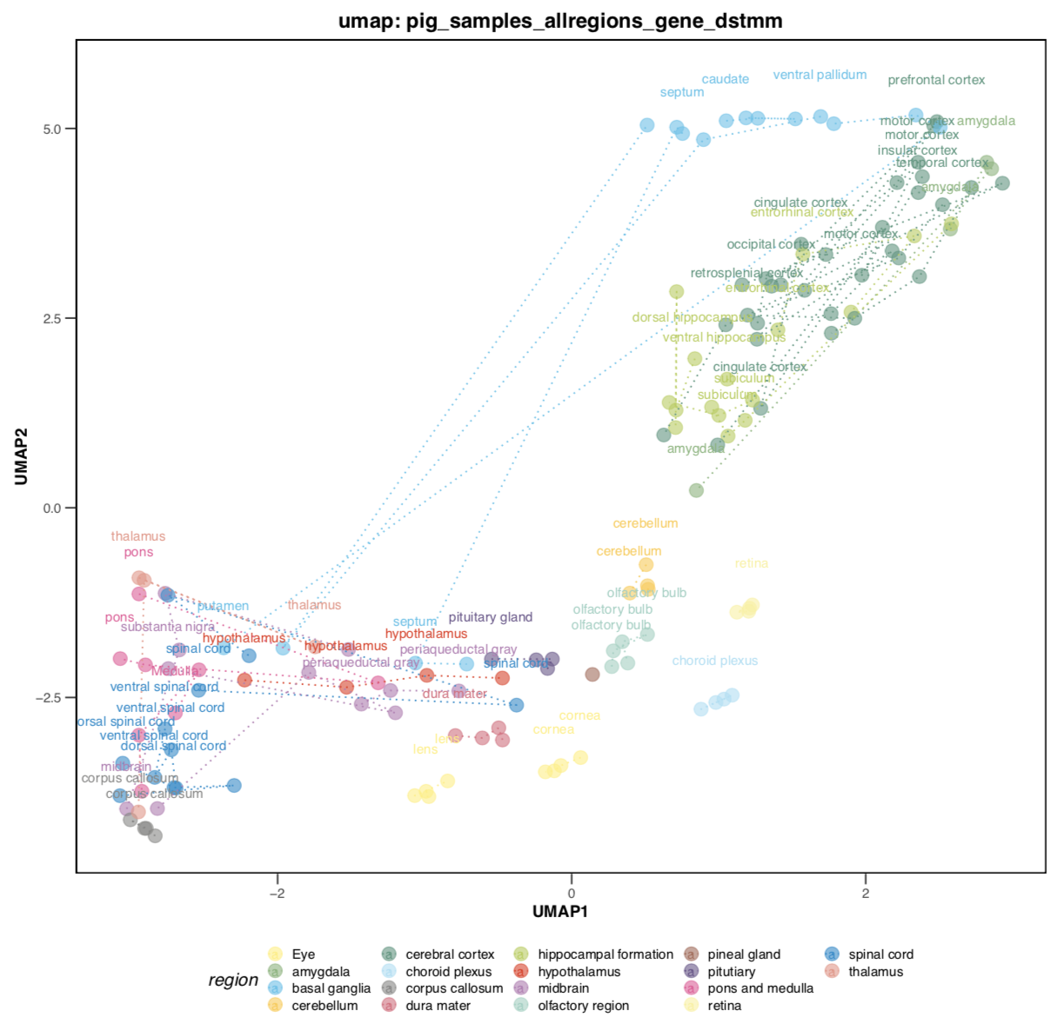
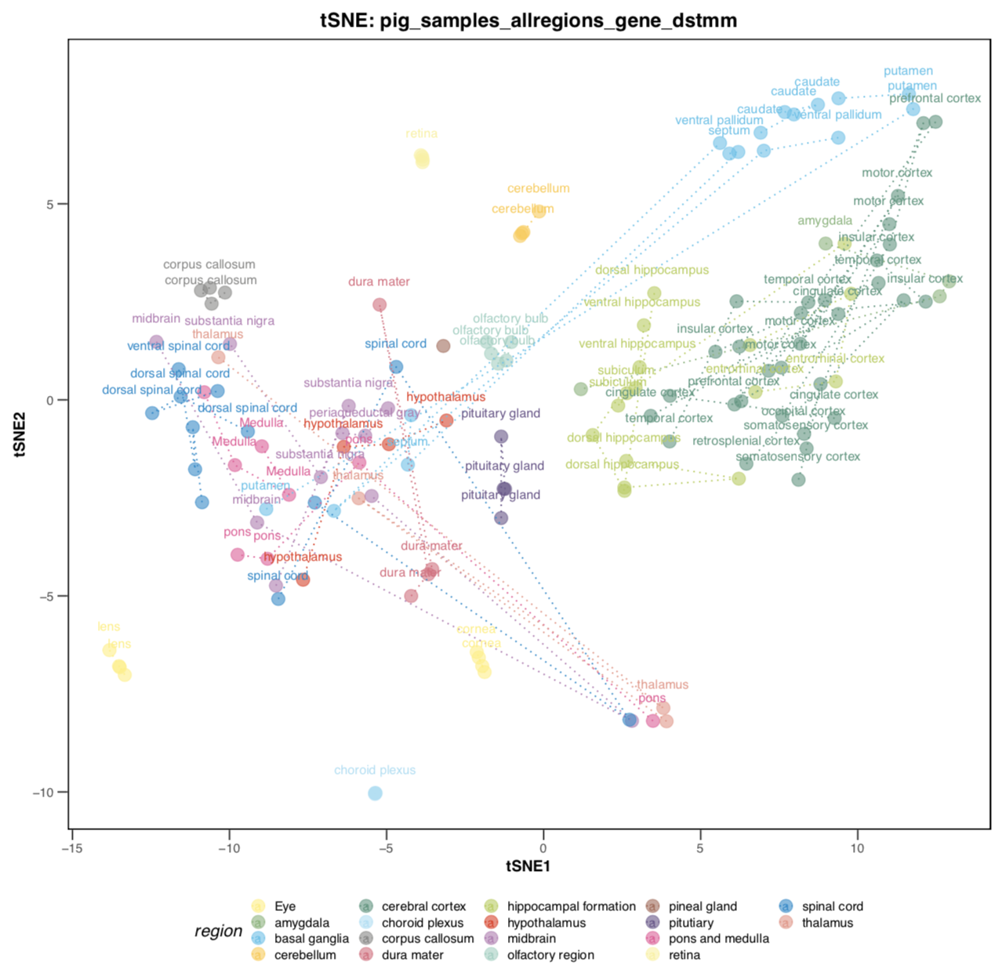
Overview – raw data (pig, all samples)

Slide 6
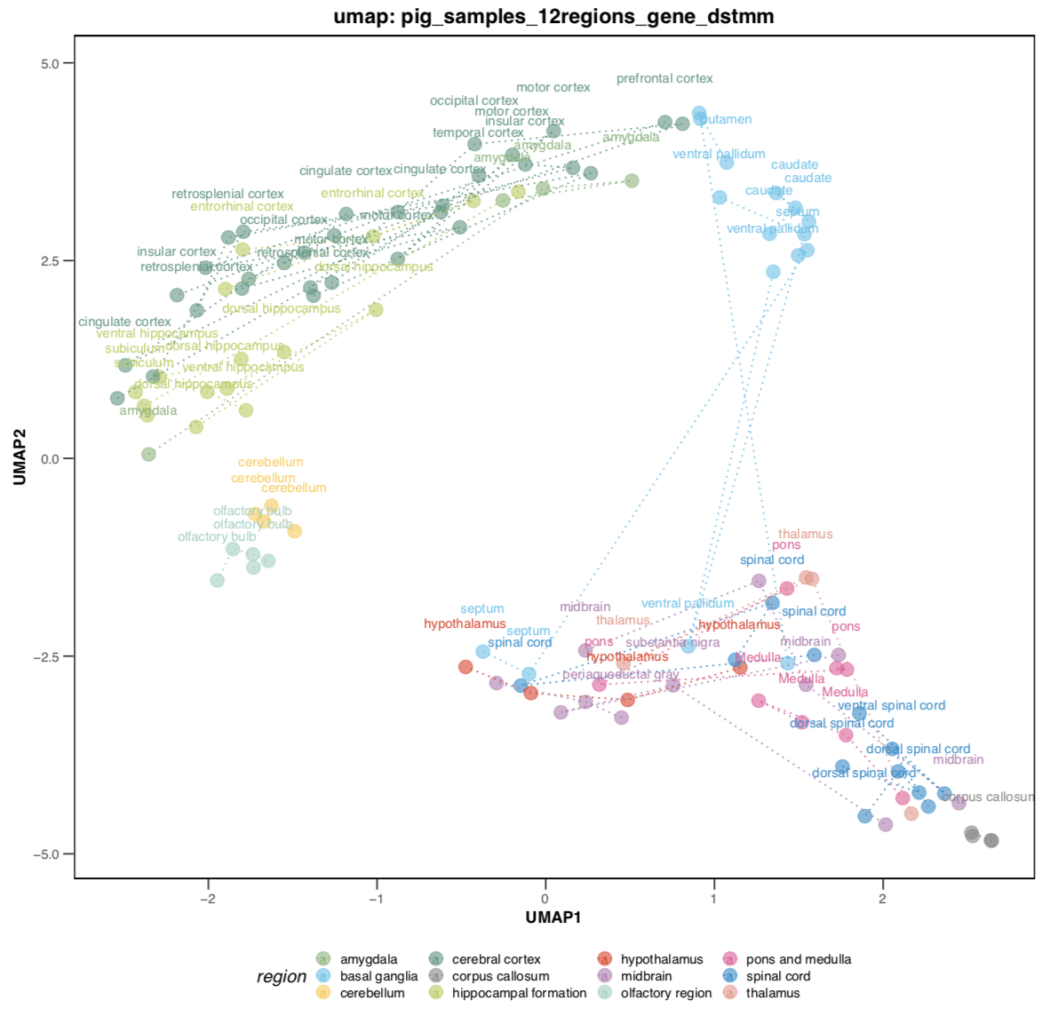
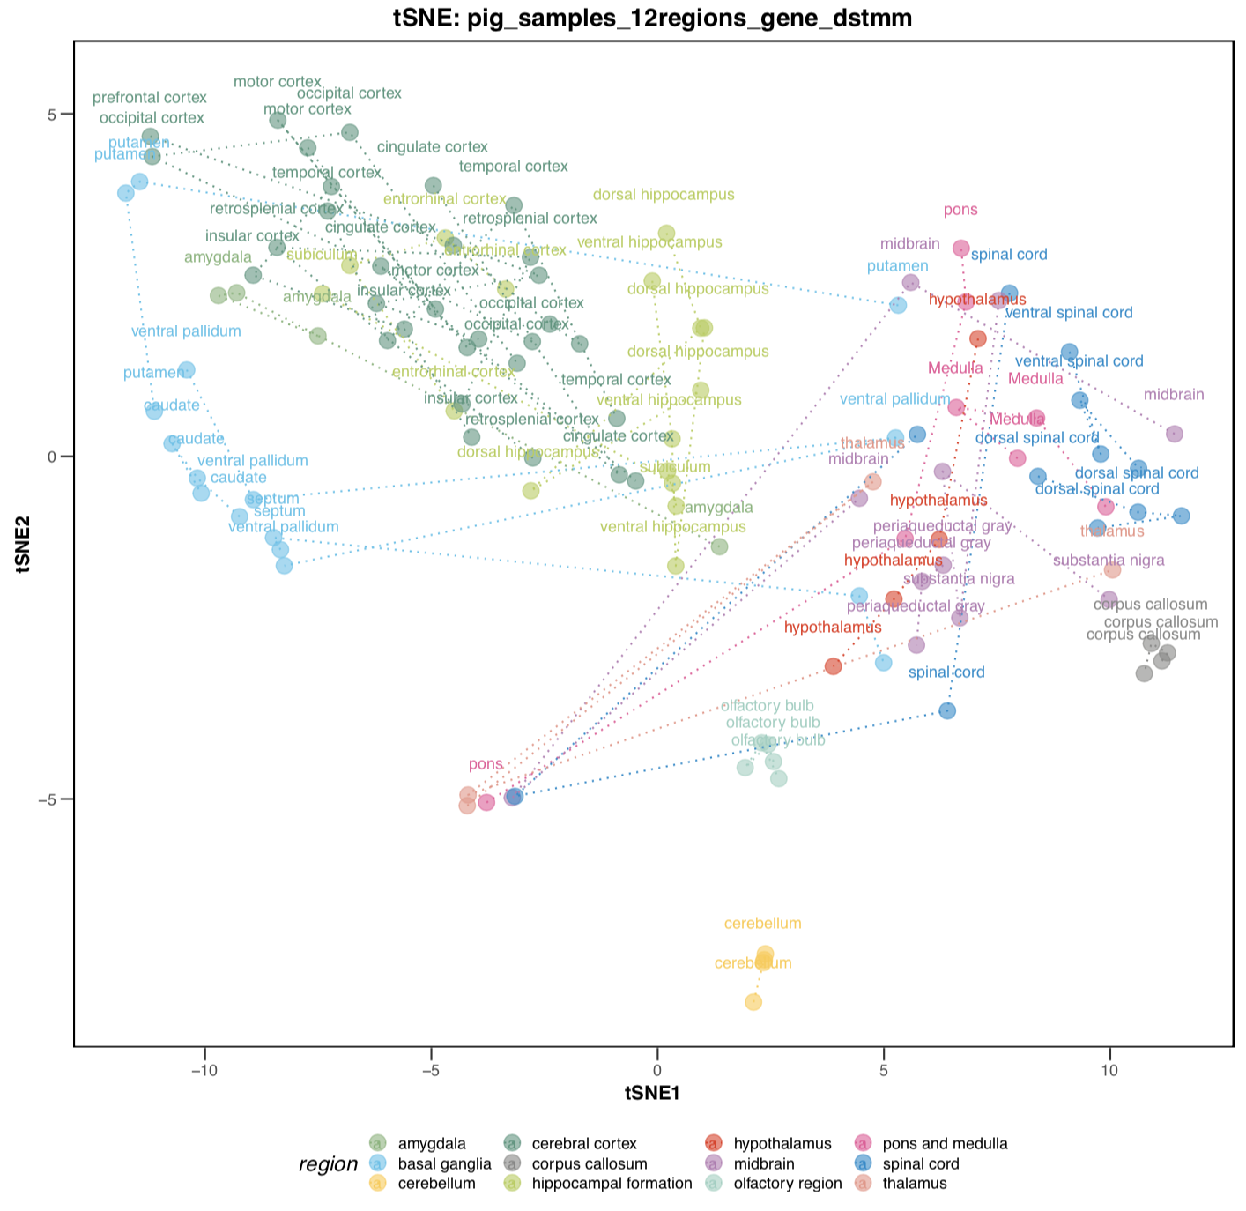
Overview – raw data (pig, 12 regions)

Slide 7
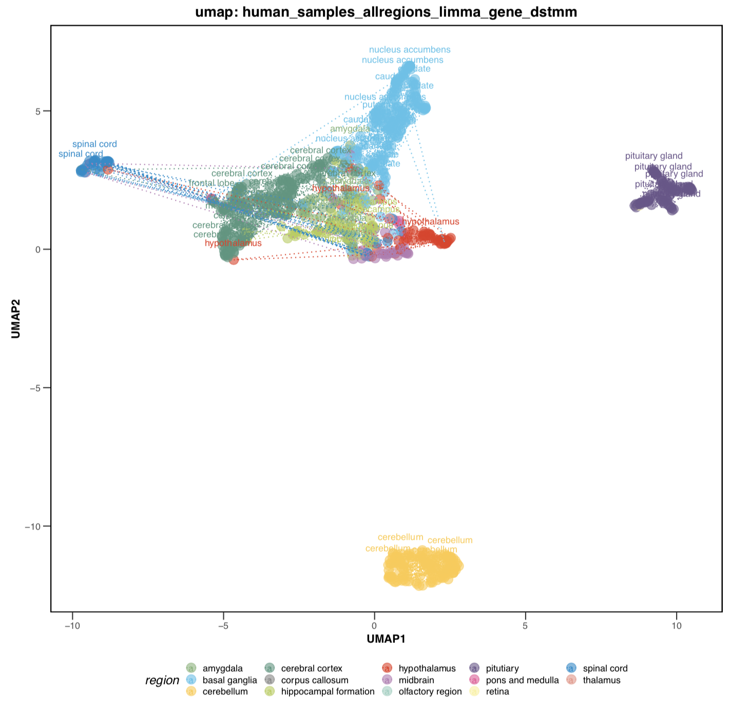
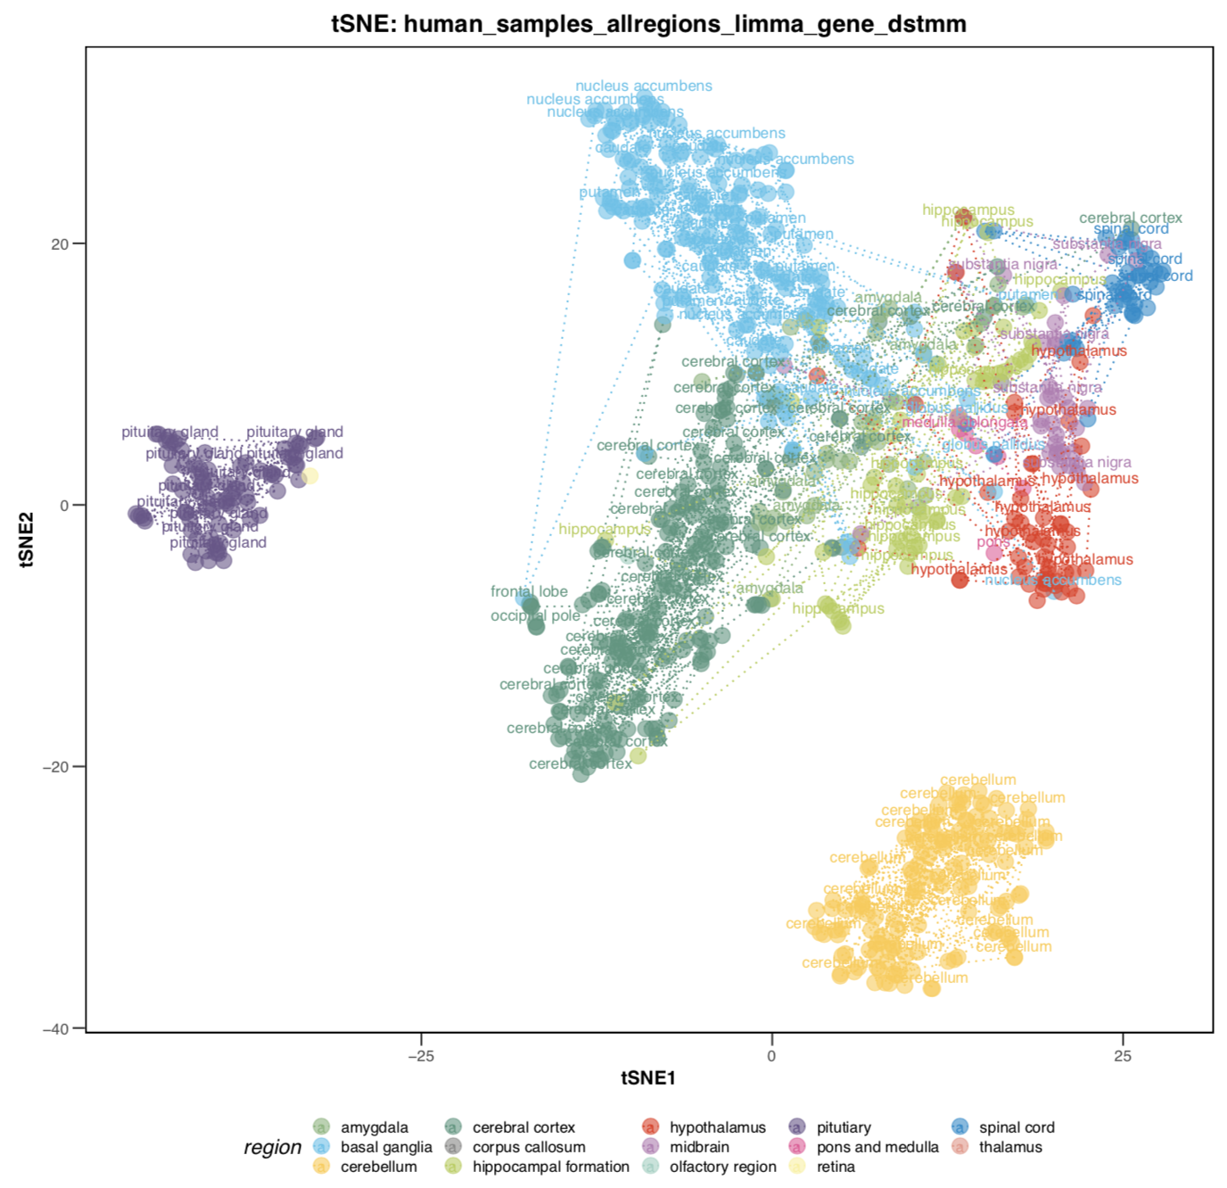
Overview – raw data (human, all samples)

Slide 8
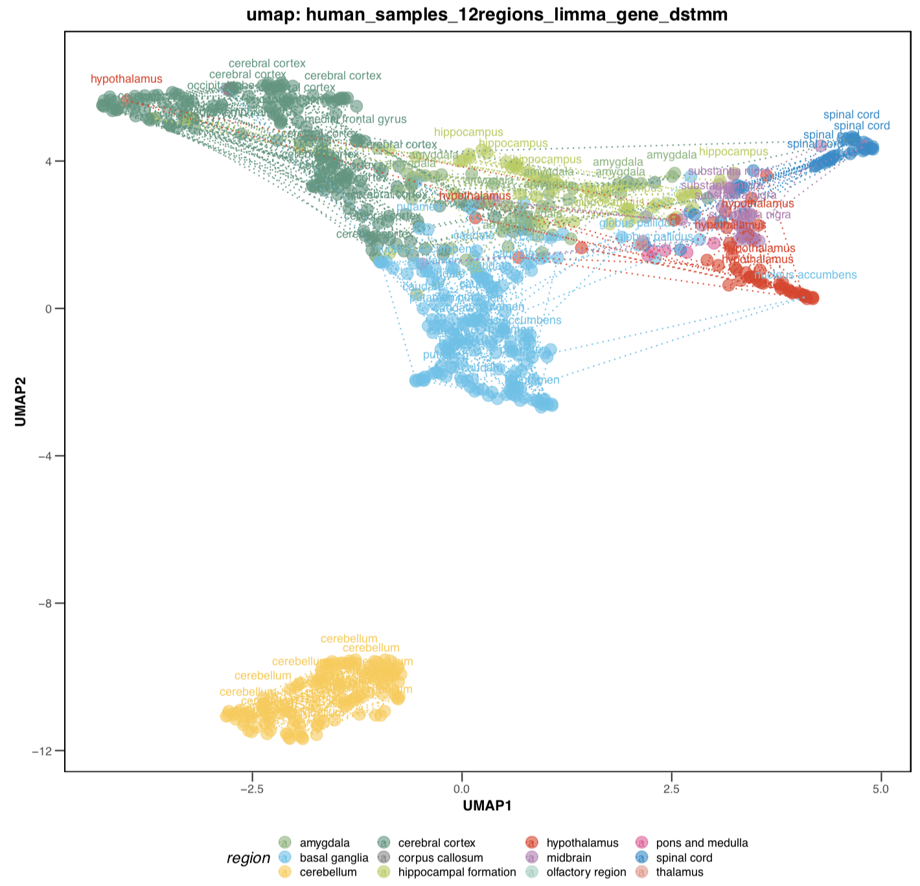
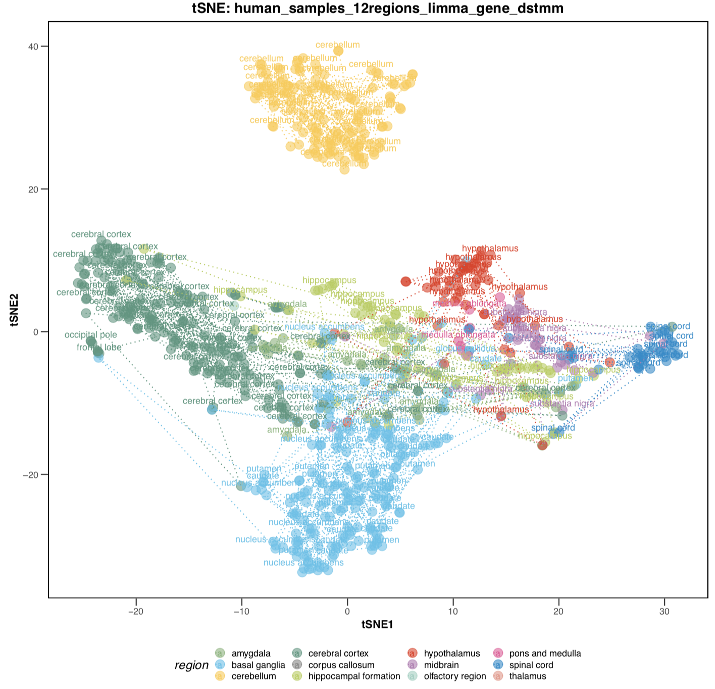
Overview – raw data (human, 12 regions)

Slide 9
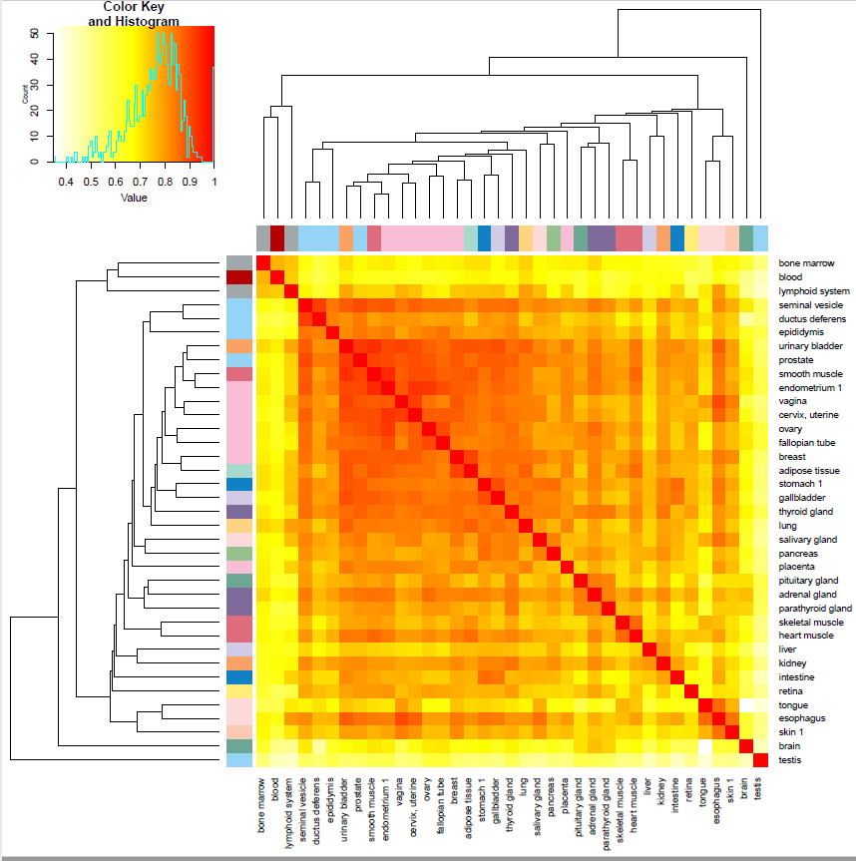
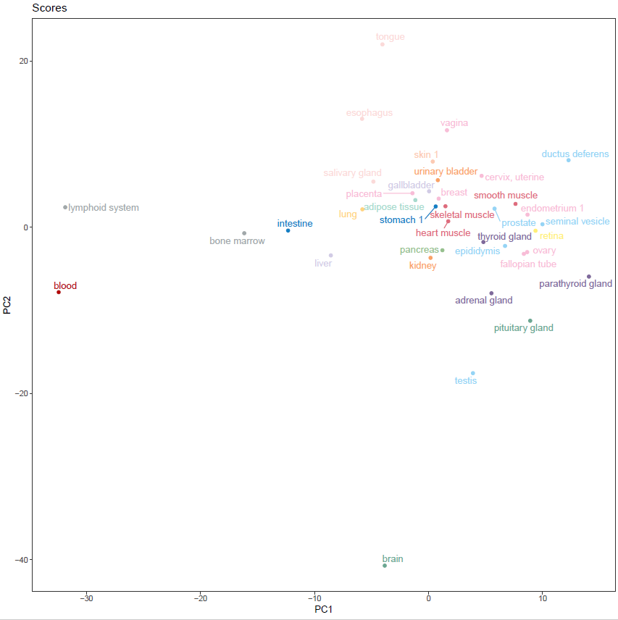
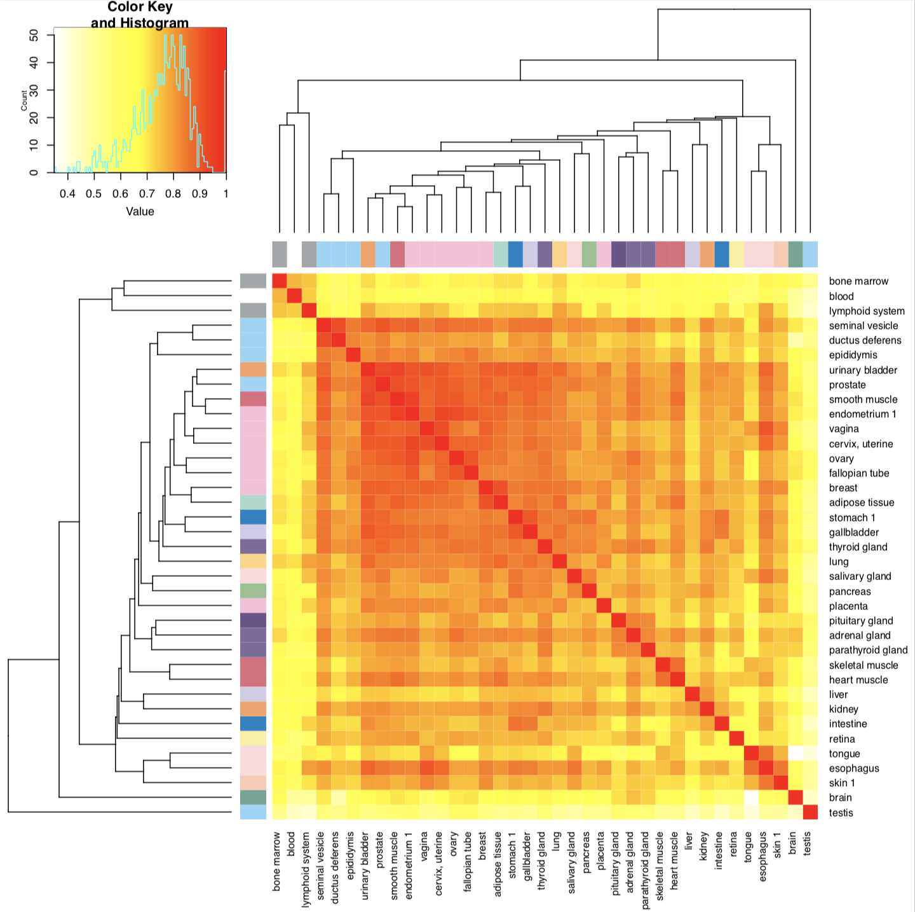
1. Overview – all tissues

Slide 10
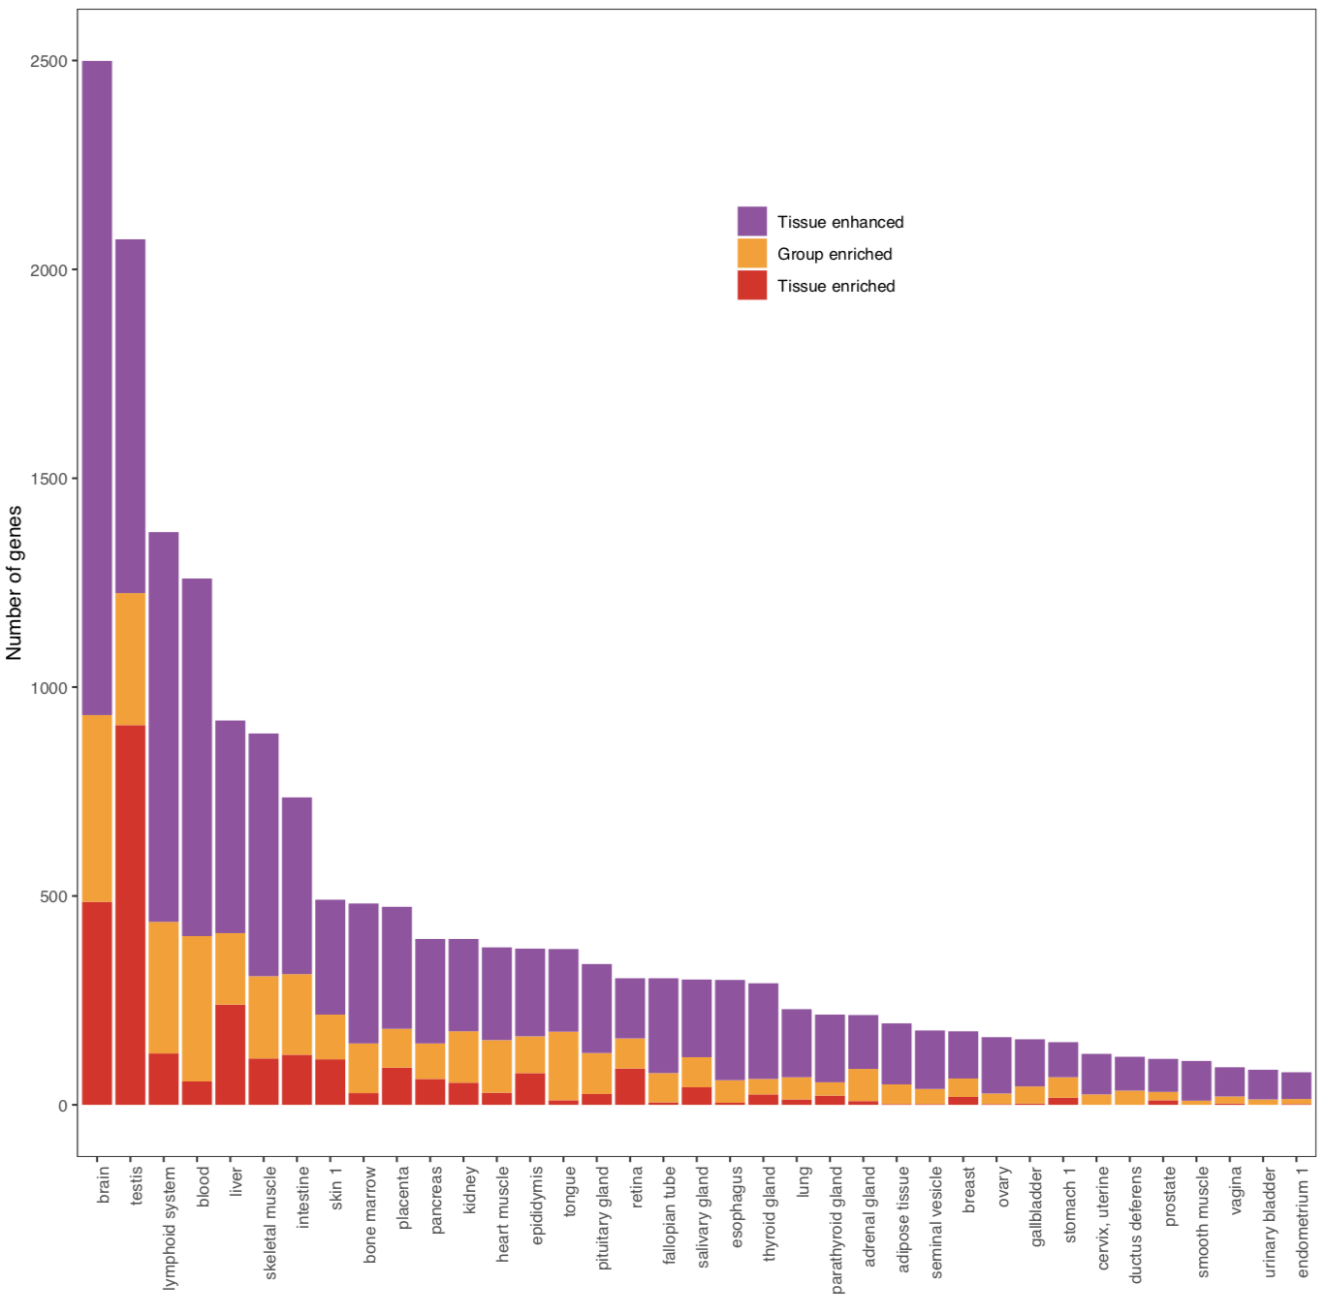
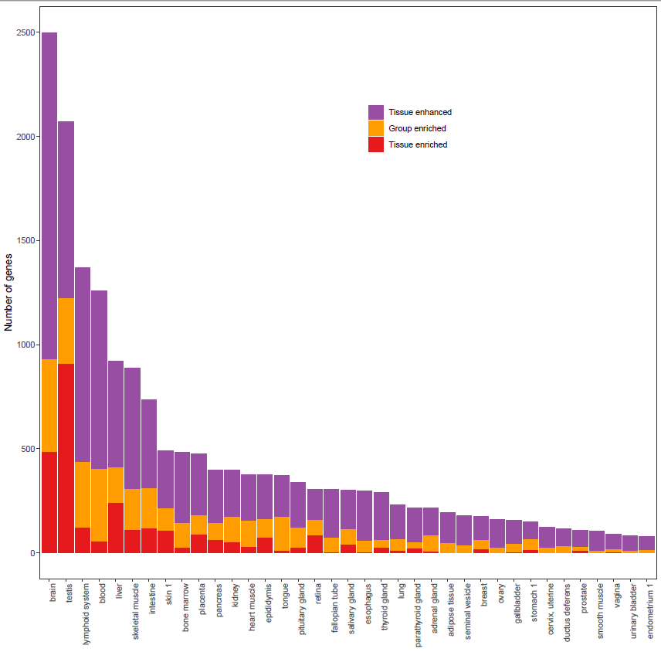
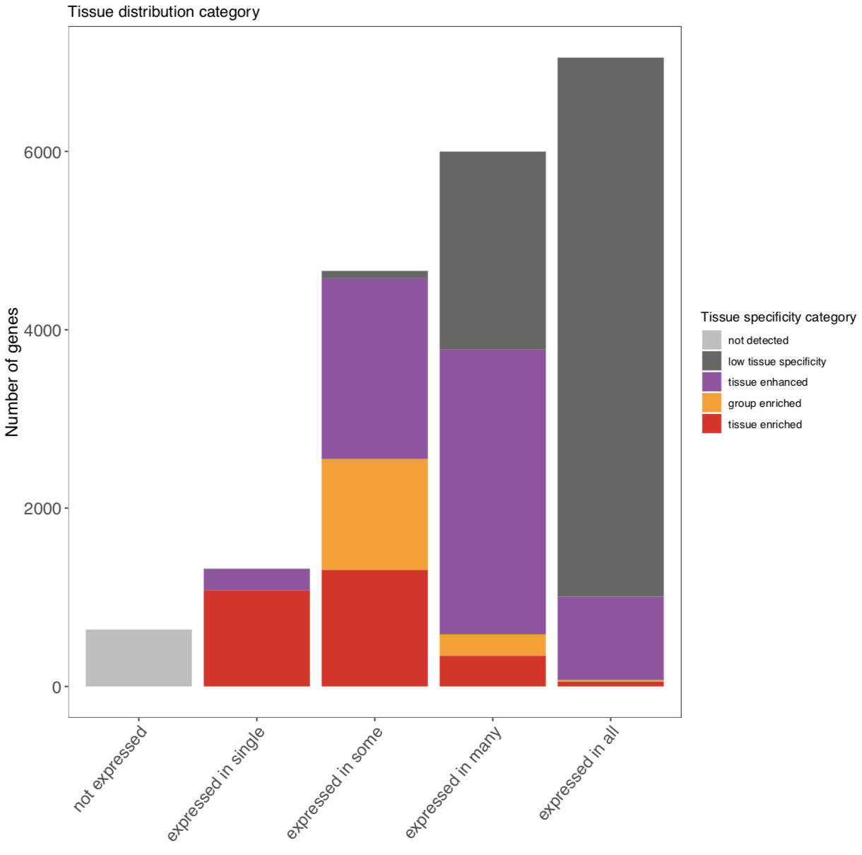
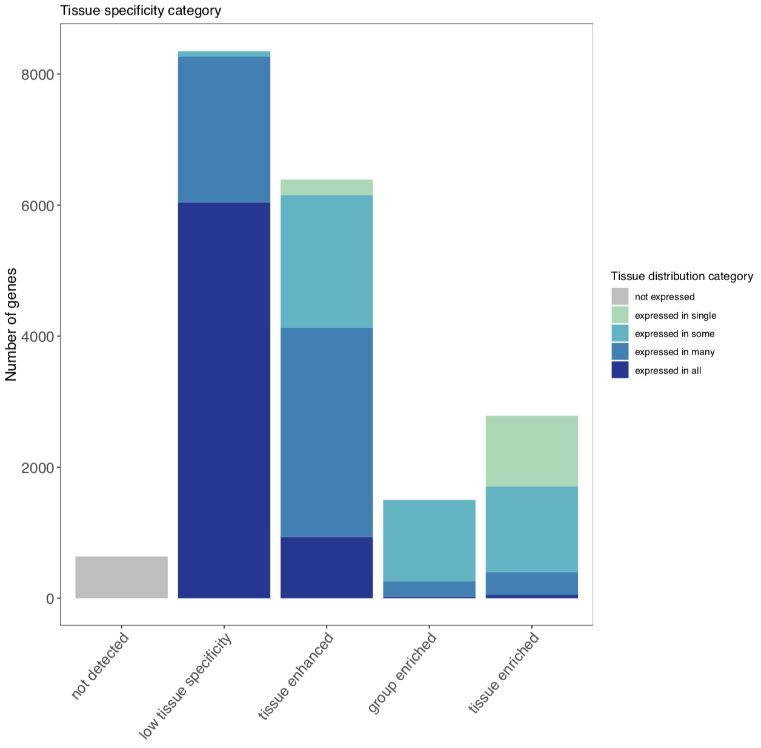
2. Categories of genes – all tissues
Tissues numbers

Slide 11
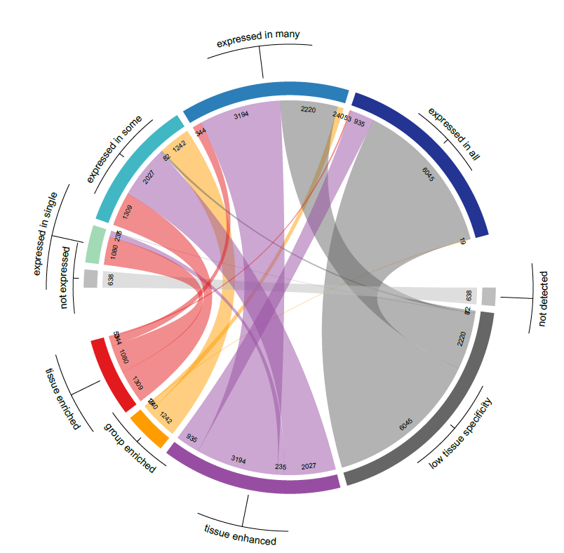
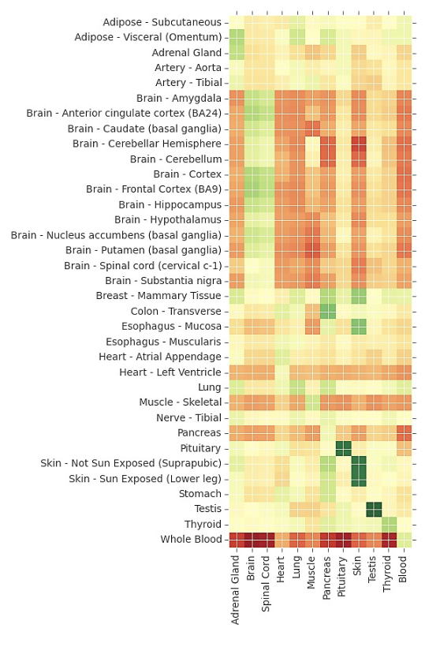
2. Categories of genes – all tissues
Tissue enriched / group enriched gene sets:
compare with mean value, red (up-regulated), green (down-regulated)
Specificity

Slide 12
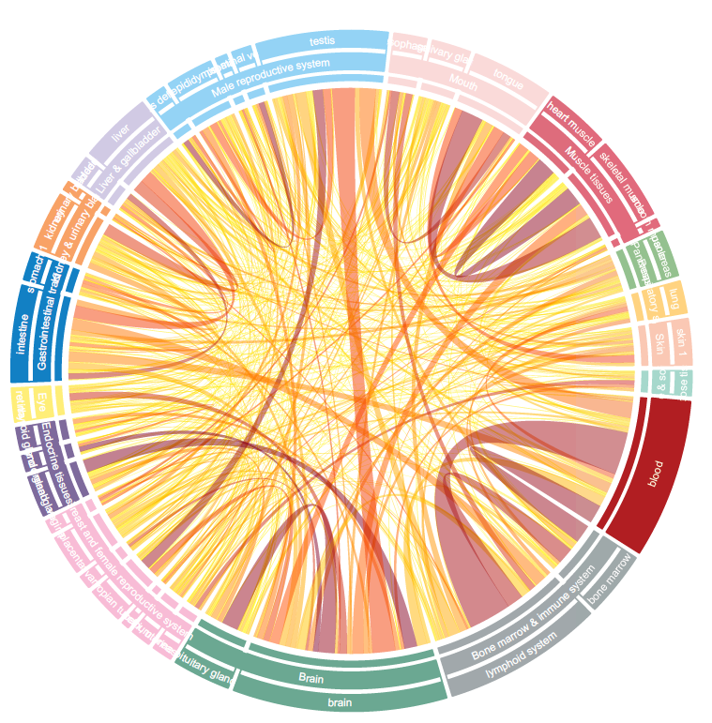
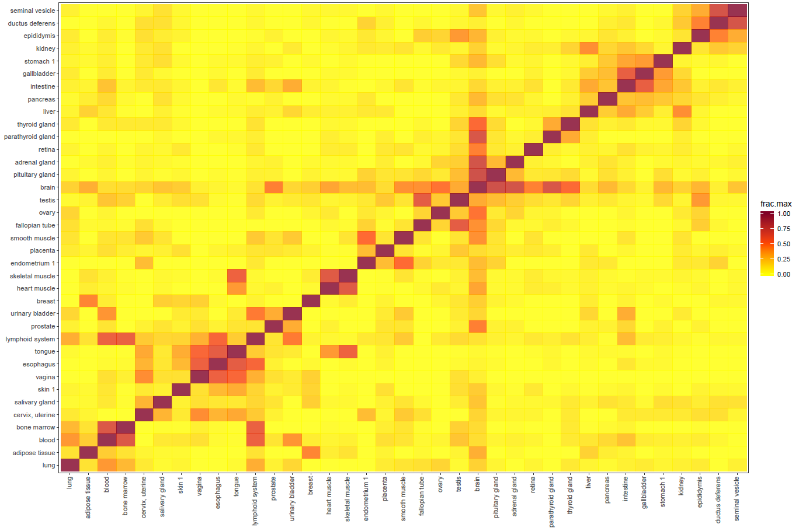
2. Categories of genes – all tissues

Slide 13
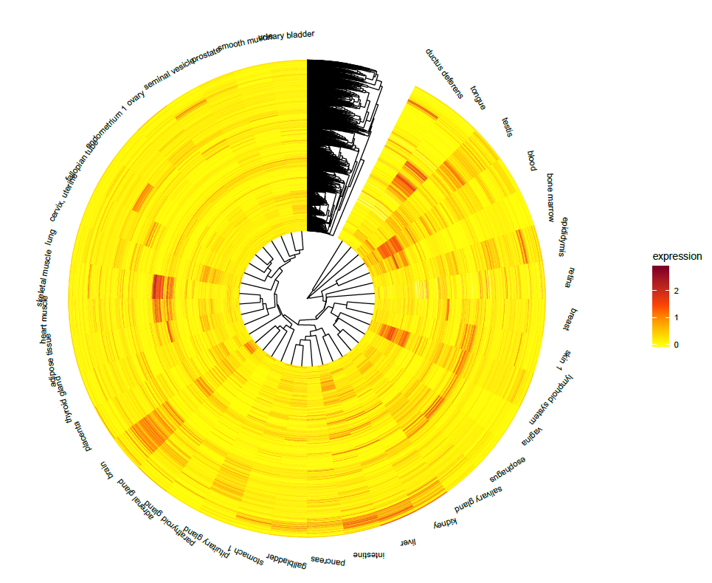
2. Categories of genes – all tissues

Slide 14
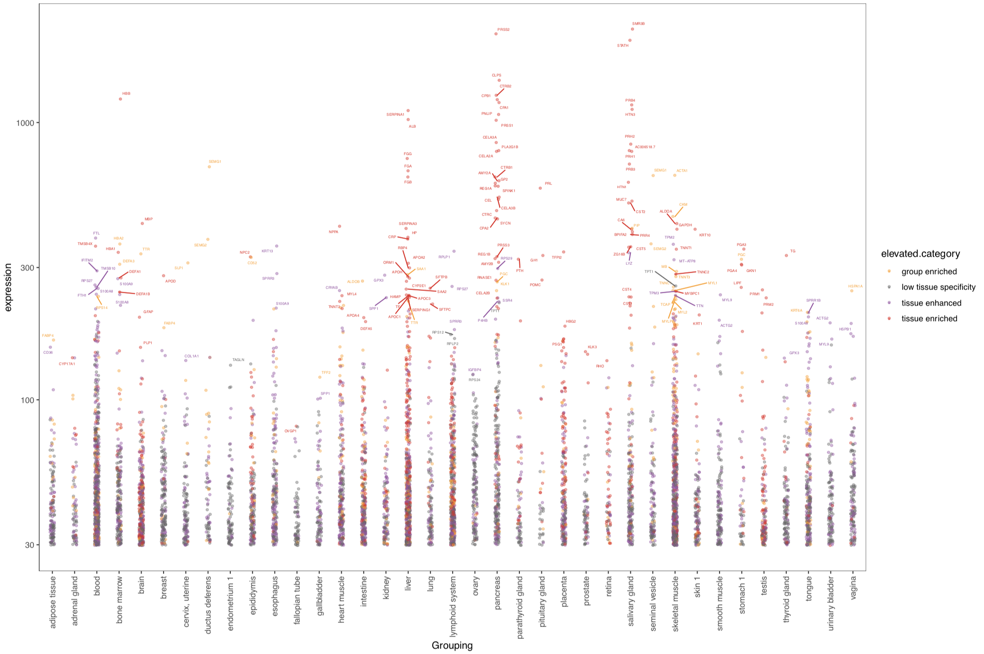
3. Elevated genes – all tissues (Max)
Top 1% abundance genes plus top 10 per tissue
Just tissue enriched genes

Slide 15
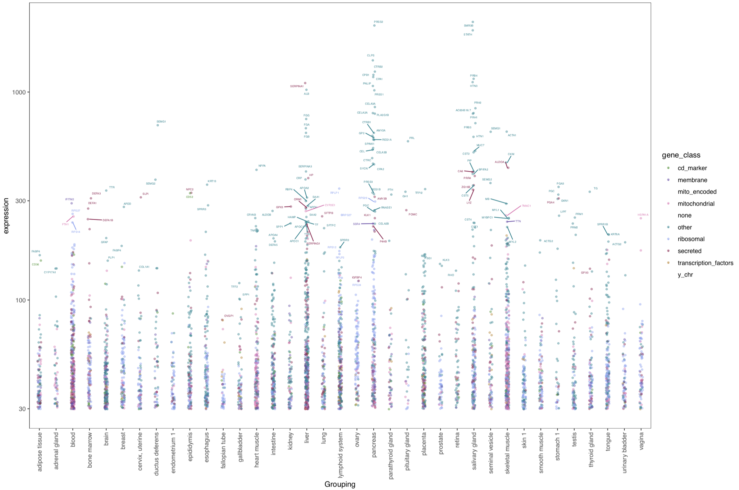
3. Elevated genes – all tissues (Max)
Other classifications of genes???

Slide 16
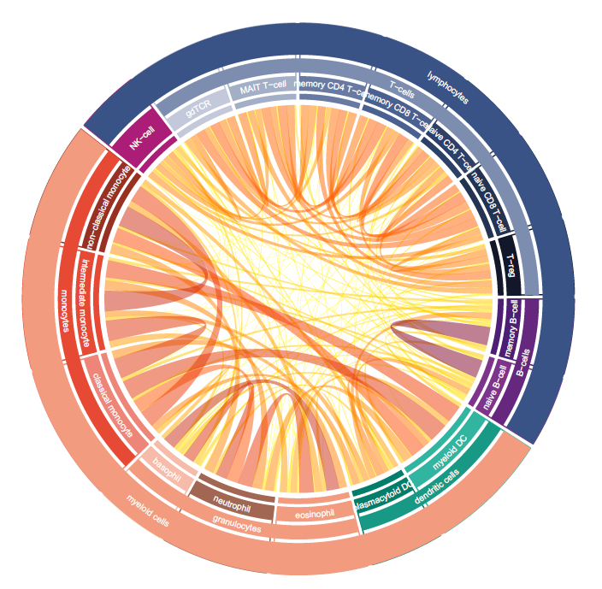
4. Blood / Brain atlas – hierarchy plot (2. Wen)
1
2
Network of overlap genes
Or overlap gene numbers
Heatmap of gene numbers
cytoscape
Group enriched chord plots (blood 2 versions with 6/18 types, brain 12 regions) , add bar plot (numbers of different categories)

Slide 17
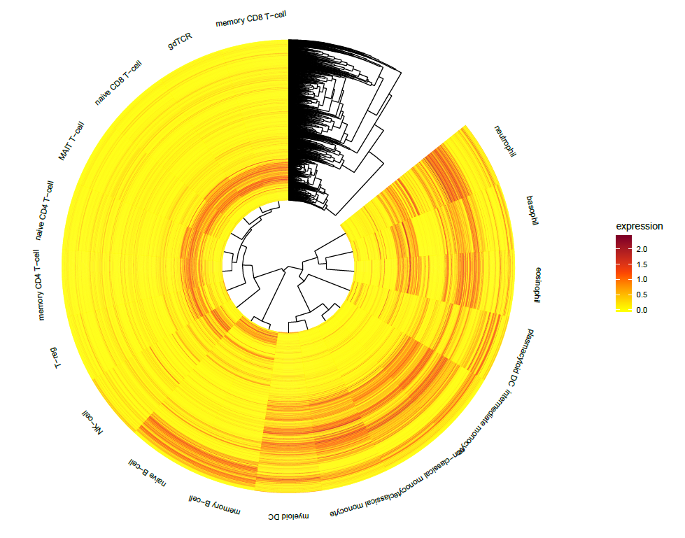
4. Blood / Brain atlas – hierarchy plot (2. Wen)
Log10 NX of group enriched genes

Slide 18
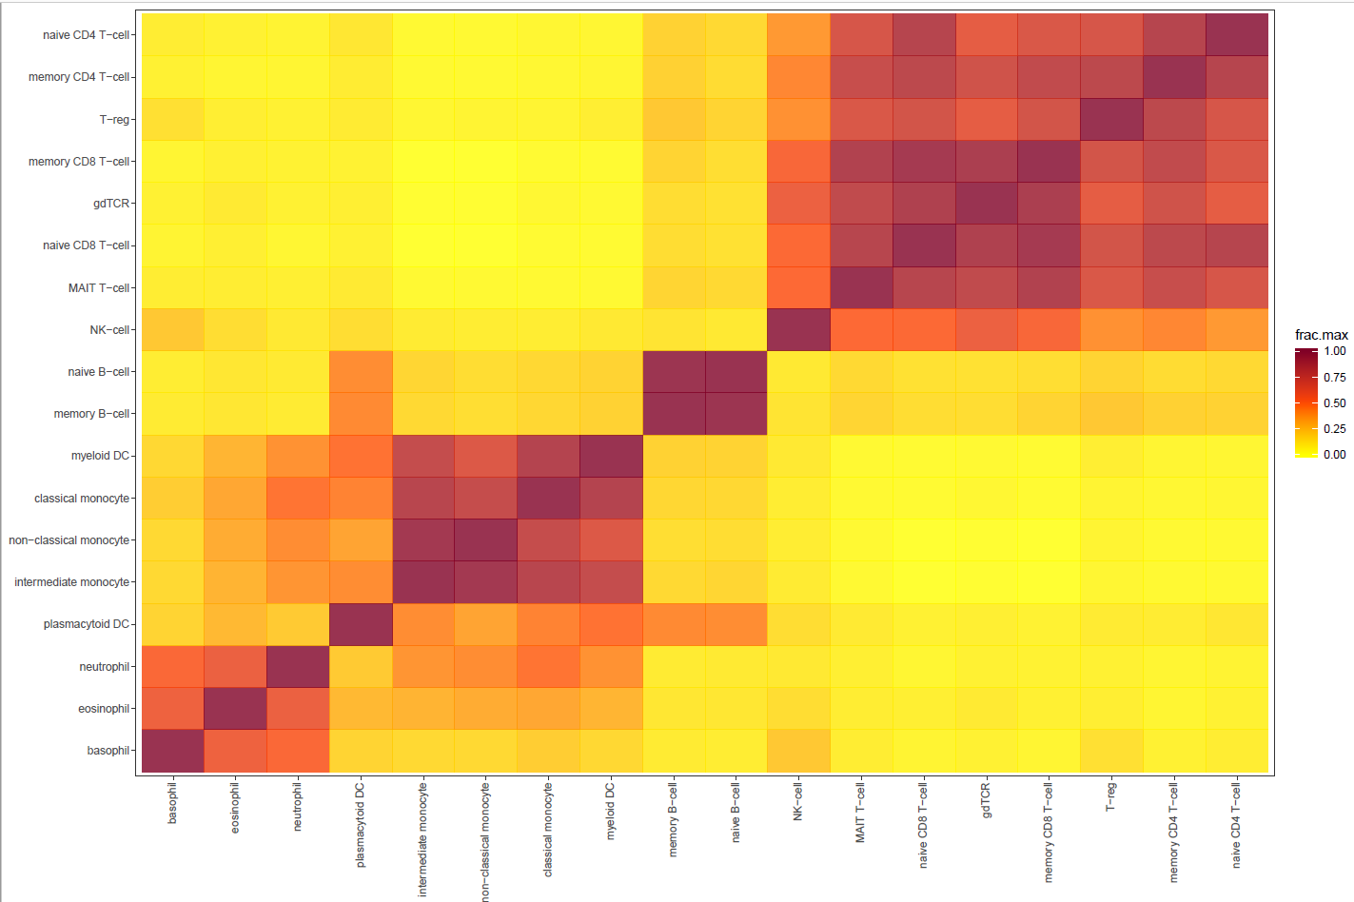
4. Blood / Brain atlas – hierarchy plot (2. Wen)
Max fraction of number of intersecting group enriched genes to total number of group enriched genes in that tissue

Slide 19
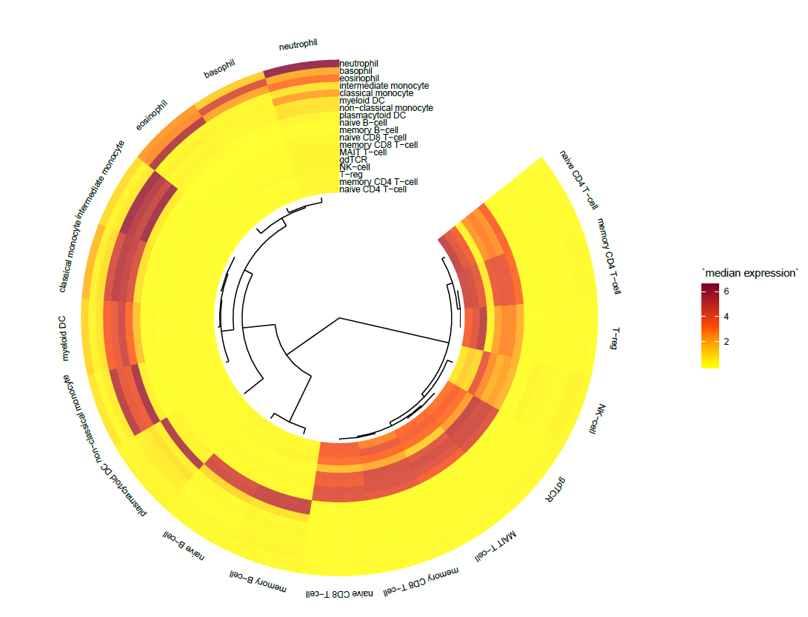
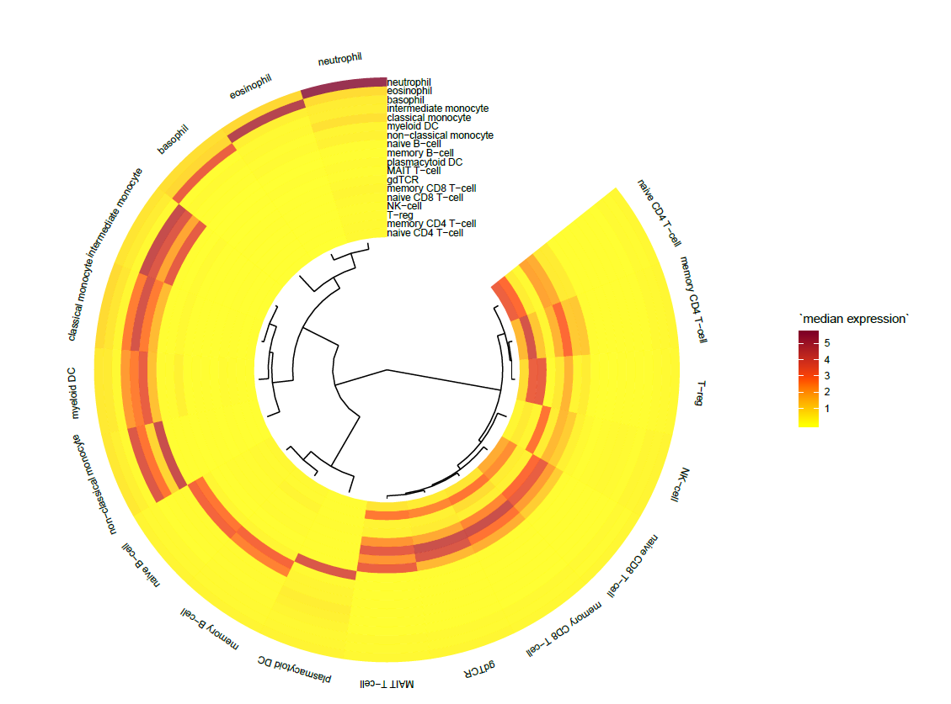
4. Blood / Brain atlas – hierarchy plot (2. Wen)
Log10 median NX of group enriched genes
Log10 median NX of all elevated genes

Slide 20
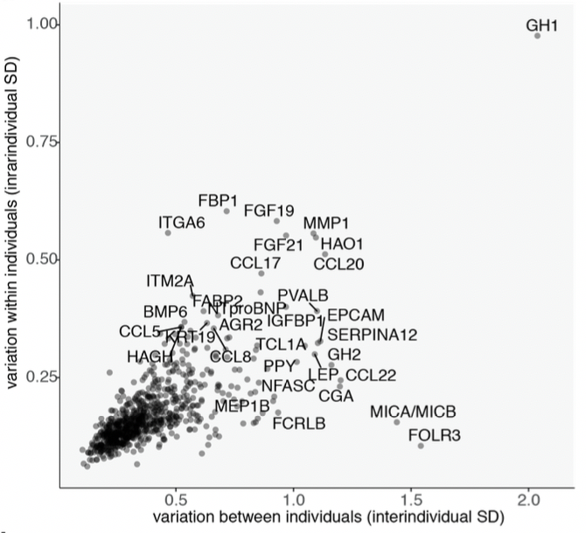
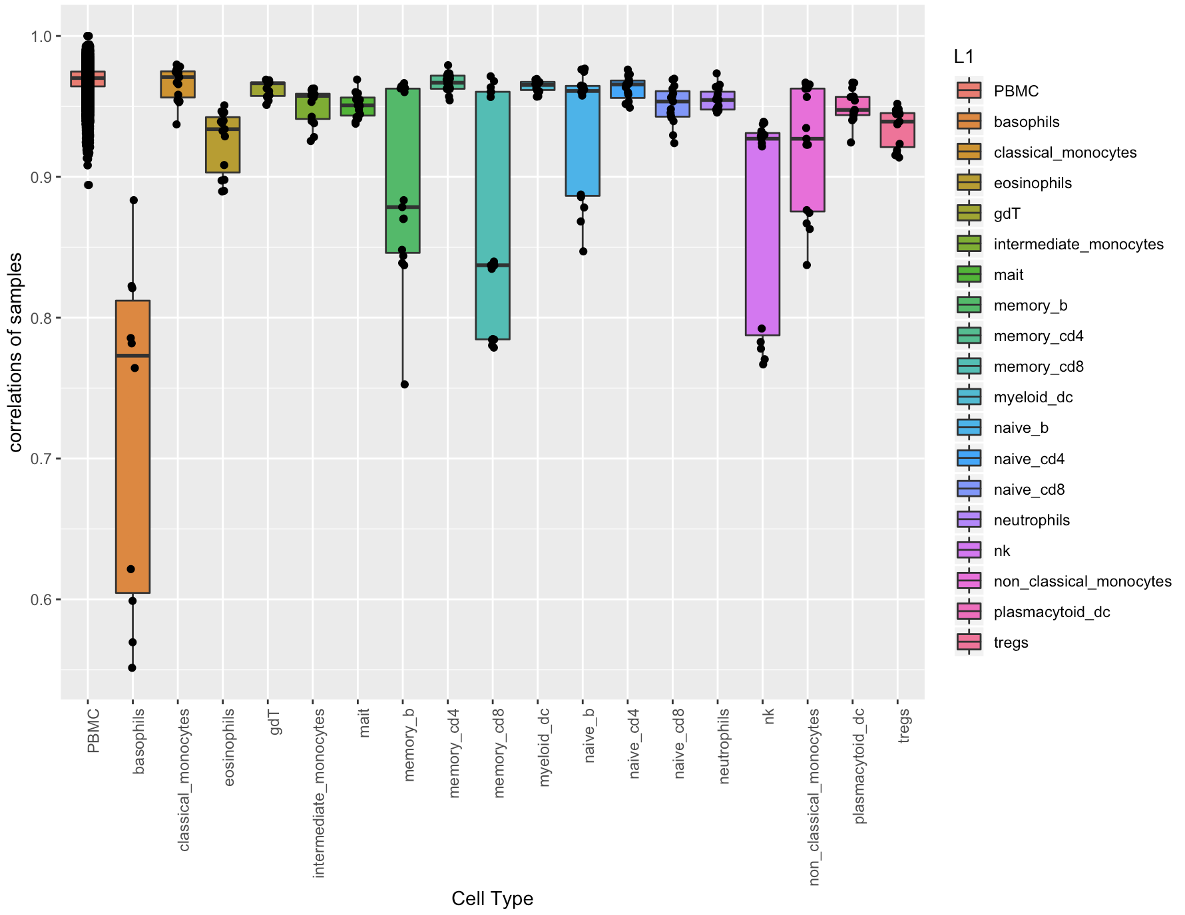
5. Blood / Brain atlas – variance analysis (Wen)
Compare CVs of genes (within tissues and among tissues)
Correlations of Samples within tissues or tissue variations
distribution of CVs of genes - different tissues

Slide 21
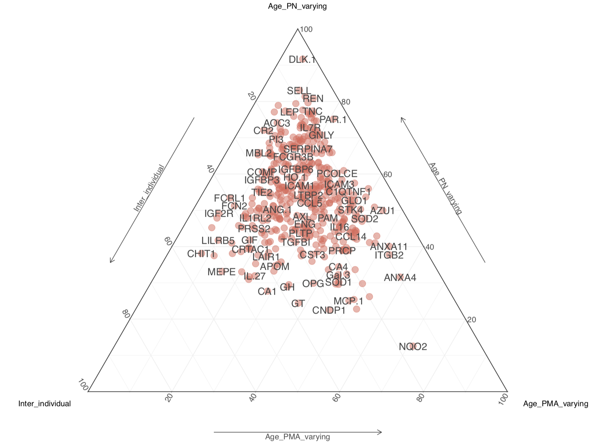
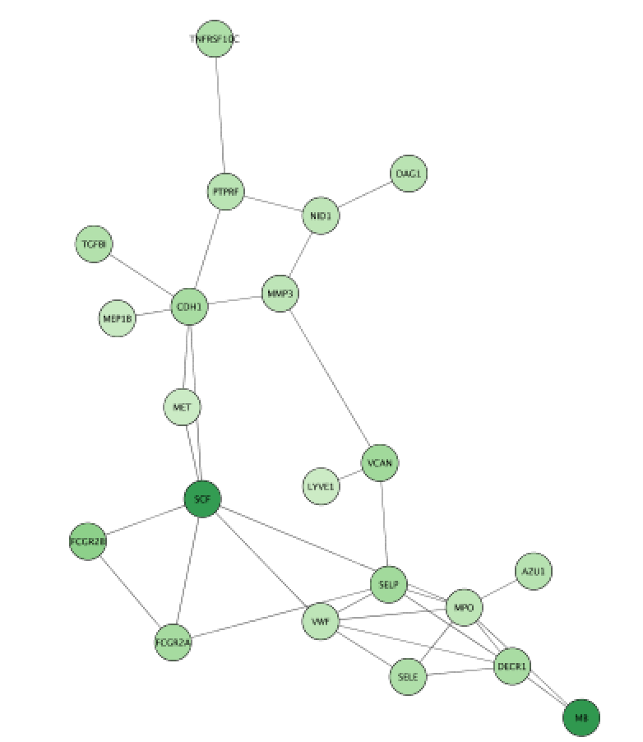
5. Blood / Brain atlas – variance analysis (Wen)
Triangle plot: analysis the variances of subjects and tissue types
Tissue_varying
Select significantly tissue associated proteins, draw network
map tissue expression values to the network
Individual_varying
Residuals

Slide 22
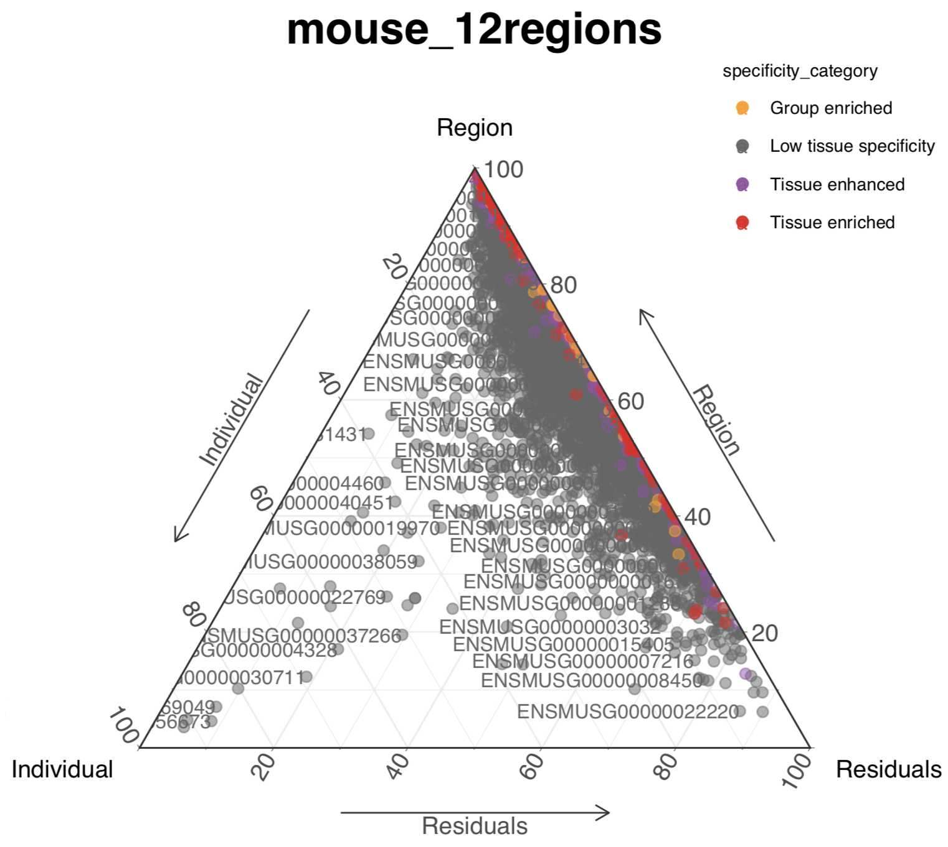
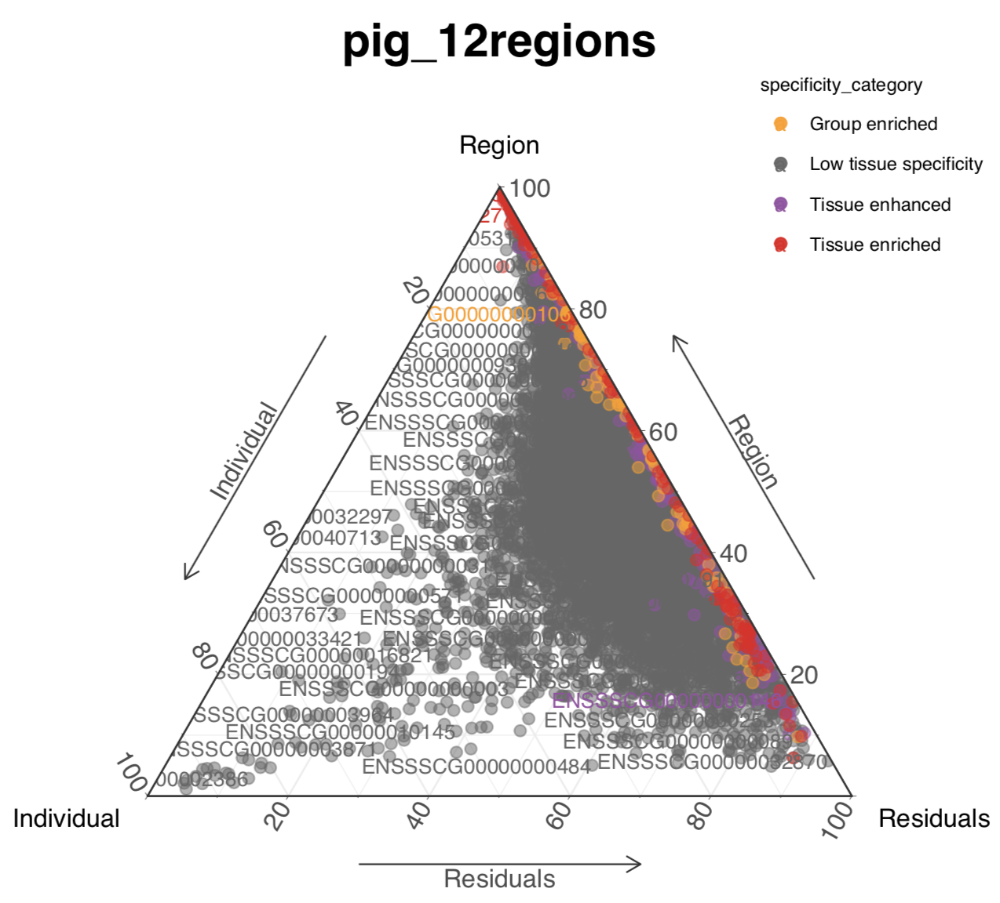
Variance analysis
Interindividual variances of most proteins are very low

Slide 23
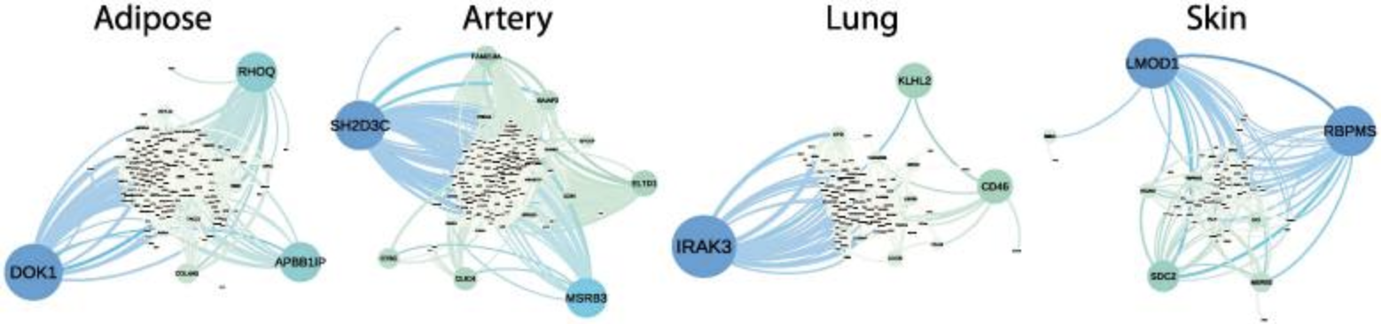
6. Blood / Brain atlas – region/cell specific network (Wen)
Bayesian Biclustering or other methods (PPI of elevated genes?)

Slide 24
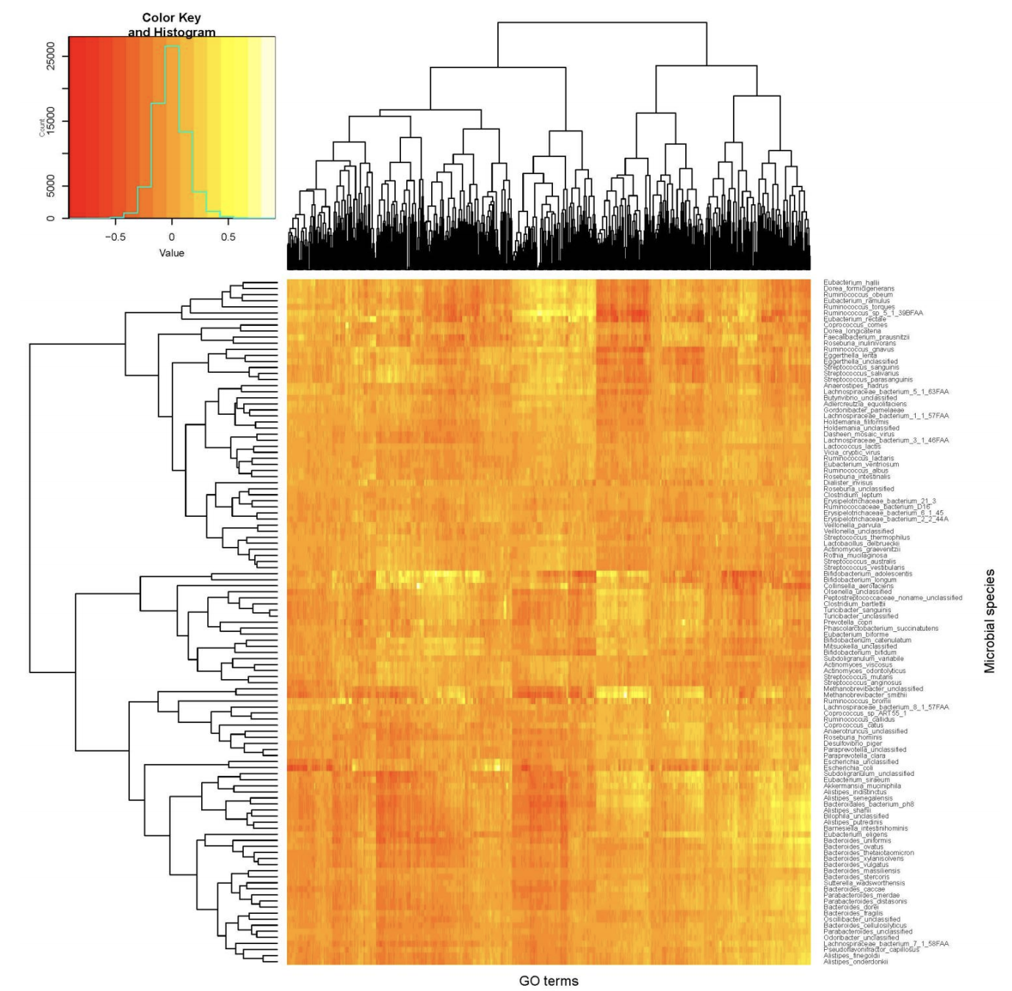
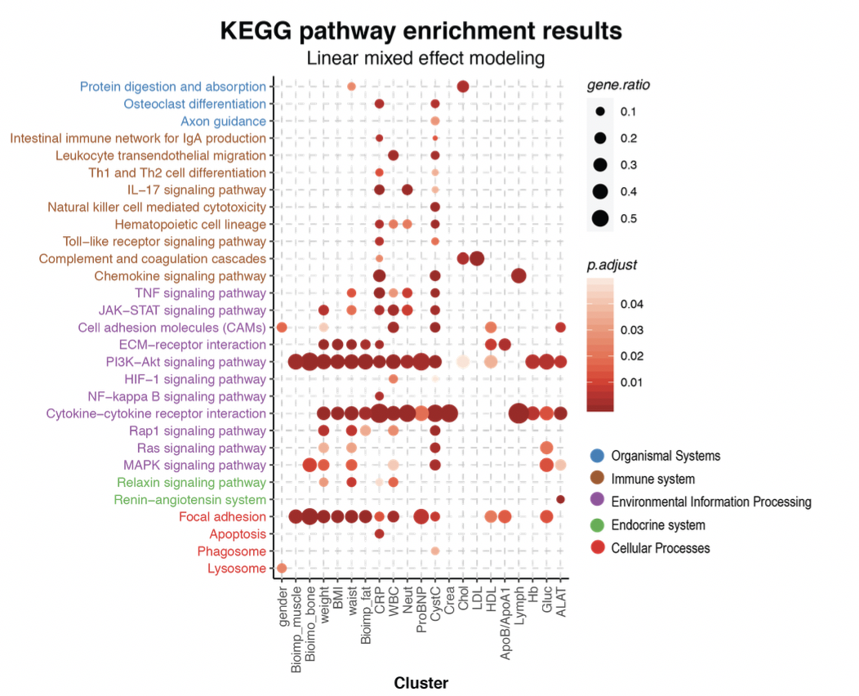
7. Blood / Brain atlas – functional analysis (Wen)
Correlations or co-expression on function level (GO term or pathways)

Slide 25
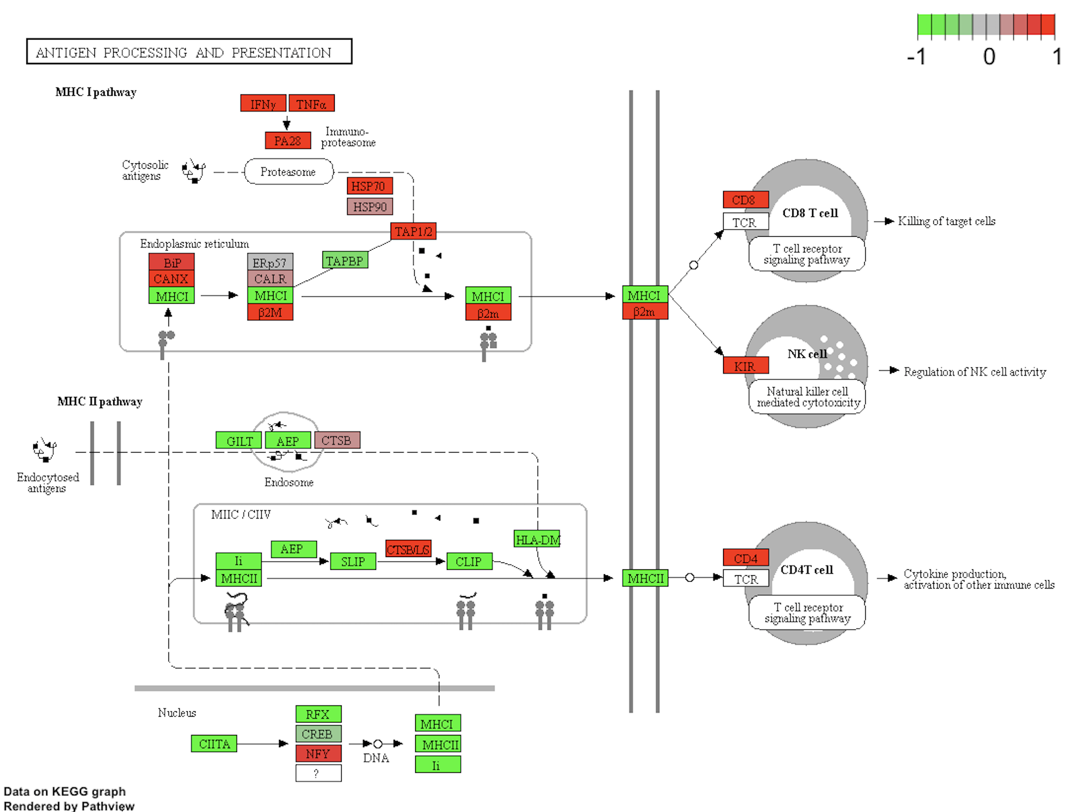
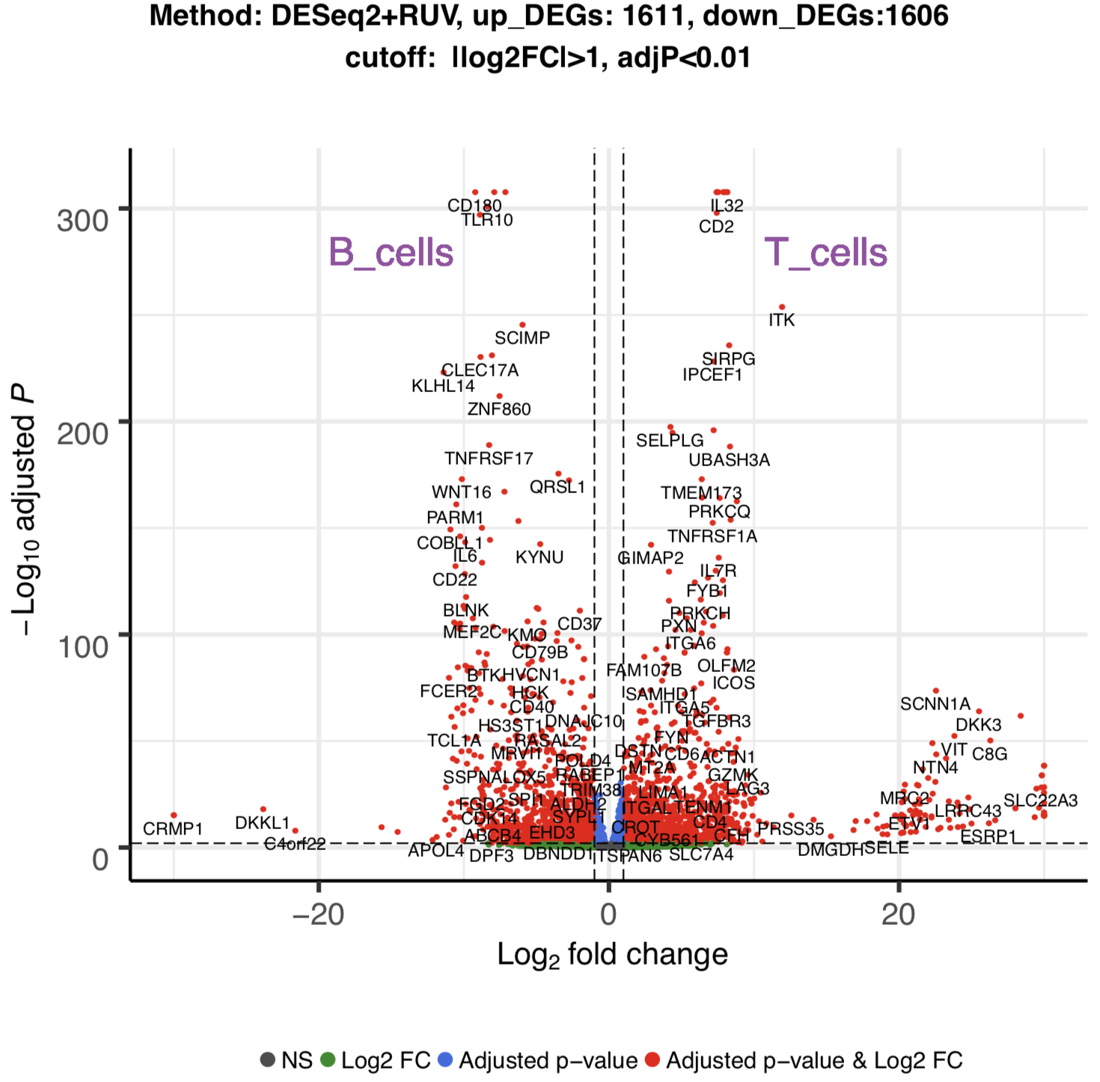
8. Blood / Brain atlas – differential expression analysis (Wen)
Comparisons of interested regions
Functional analysis

Slide 26
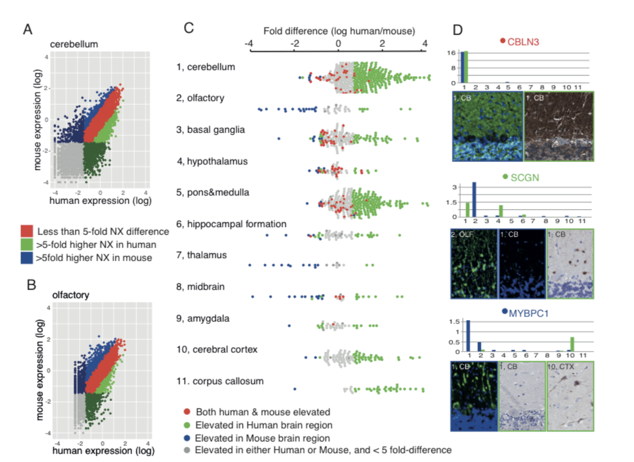
8. Brain atlas – species comparison (Wen)
Distributions of gene expression (mouse, pig, human)
triangle plots instead

Slide 27
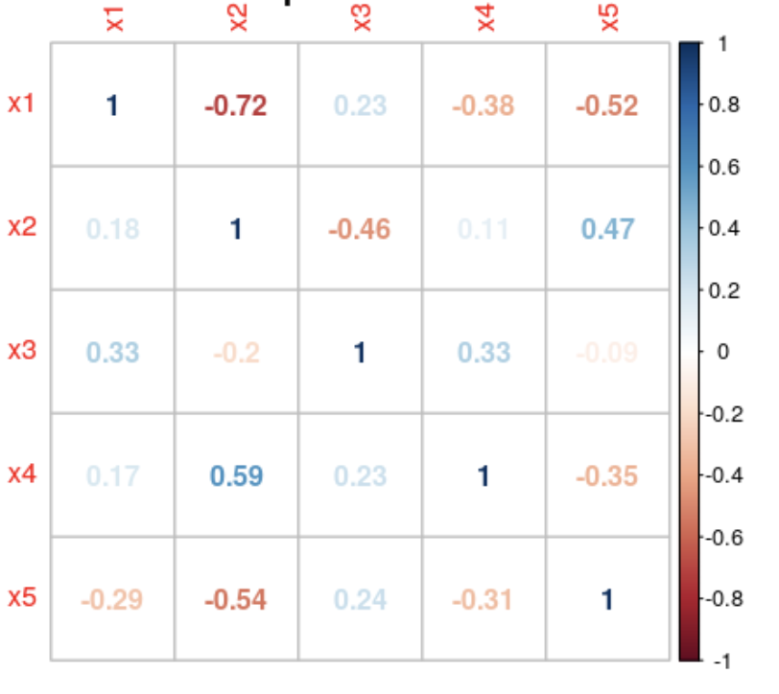
9. Brain atlas – species comparison (Wen)
Rank the variability of different regions
Correlation of different regions
Mouse
Human
Pig

Slide 28
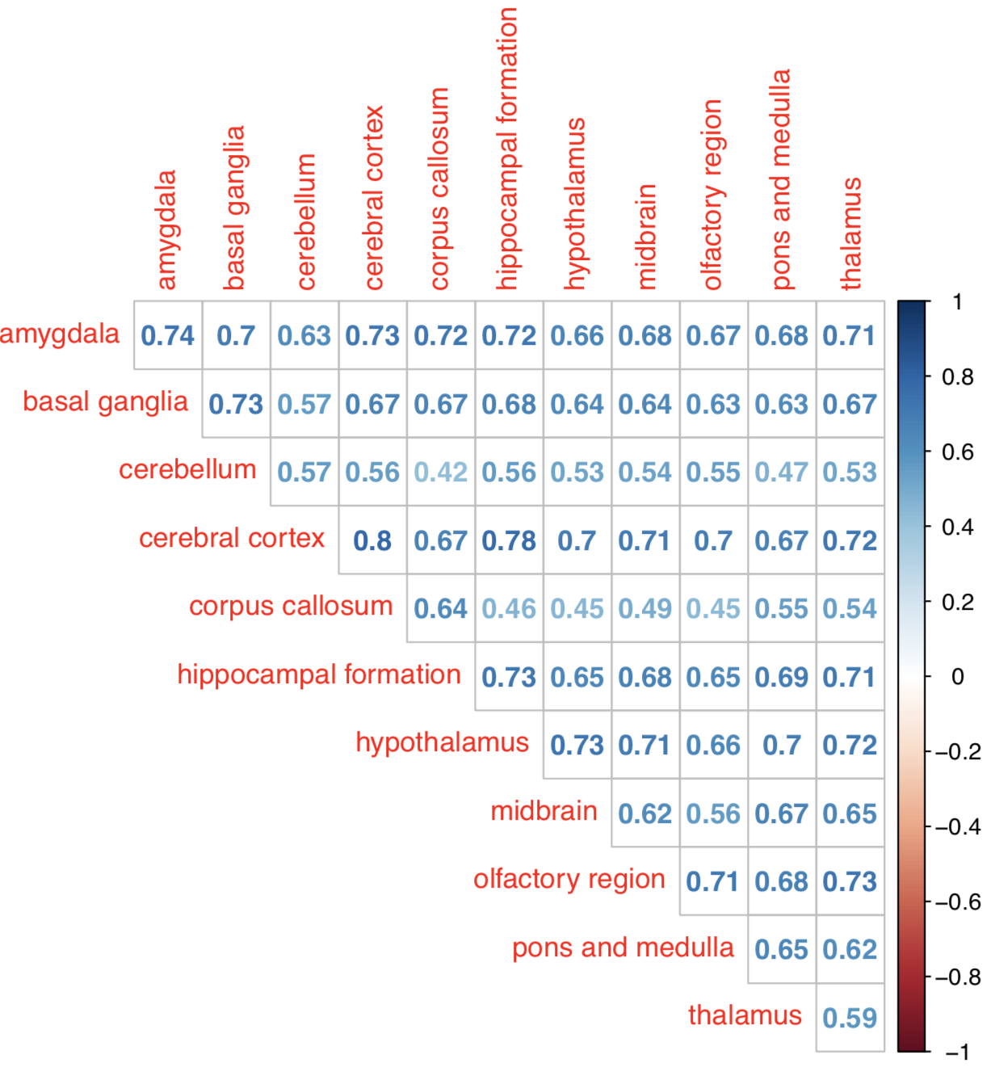
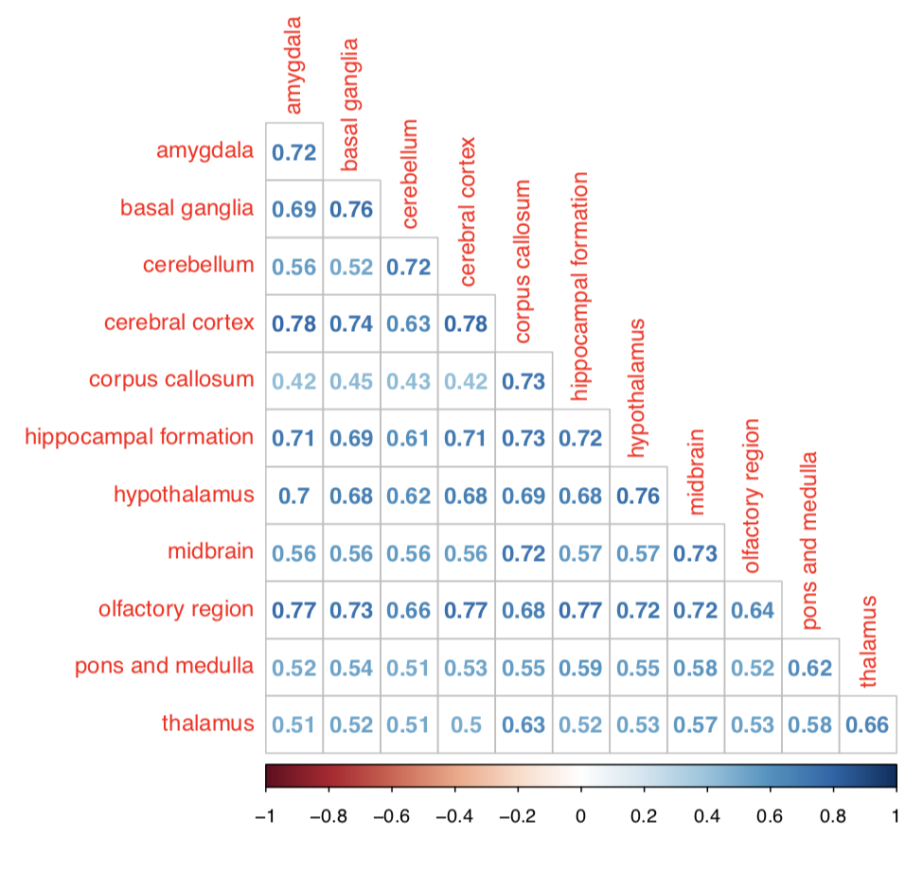
Correlation of regions
Human and pig
Human and mouse

